Slide 1
Welcome to
Conference
January 28 - 30, 2020
Expo
January 29 - 30, 2020
Santa Clara Convention Center

Slide 2
Machine Learning Applications for COM Based Simulation of 112 Gb Systems
Alex Manukovsky, Intel alex.manukovsky@intel.com
Zurab Khasidashvili, Intel
zurab.khasidashvili@intel.com
Eli Zalianski, Intel
eli.zalianski@intel.com
Yuriy Shlepnev, Simberian Inc.
shlepnev@simberian.com
Santa Clara Convention Center
January 29, 12:00pm - 12:45pm, Ballroom F

Slide 3
Outline
Introduction
ML Based Systematic Design Space Exploration
Feature Range Analysis
COM based interconnect system analysis
Interconnect modeling and feature selection
ML Design Space Exploration Examples
Conclusion

Slide 4
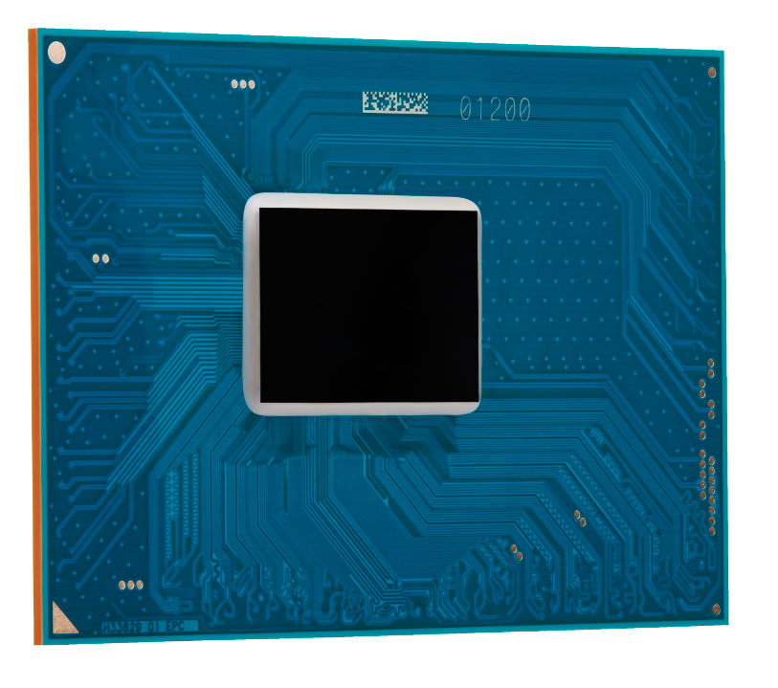
SerDes Design Challenge
100 Ports
15 Supported protocols
5 Physical Interfaces
How to approach the Design Complexity?

Slide 5
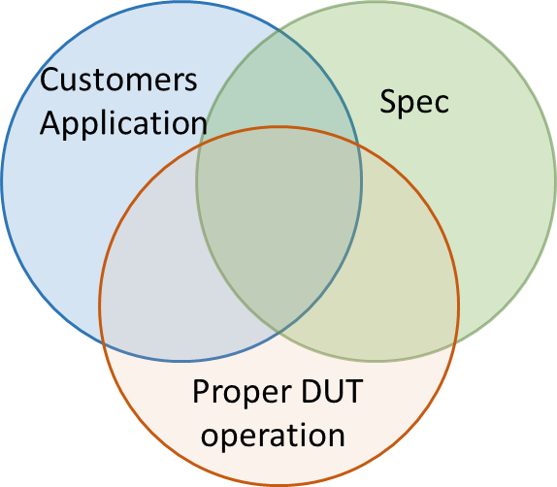
Coverage challenge in SerDes design
Multiple usage models
Compliance to multiple specifications
Unique channel requirements for each protocol
Unique requirements for each of the three test types
Different physical interfaces support
Solution space coverage
Cable lengths
PCB trace length and topologies
Connectors
EQ capabilities
PCB manufacturing tolerances
PVT Variation
Solution space chart
Too many parameters and expertise-based analysis maybe not be sufficient - an automated systematic approach is required!

Slide 6
Design Space Exploration In 4 Steps
Expert Opinion
(SI Eng)
3D EM Simulator
(Simbeor)
COM script
(Matlab)
ML
(EVA tool)
What are the important features that impact the system behavior the most?
What are the ranges of each of the important features in which we are most likely to achieve desired system response?
What are the combinations of feature ranges that enable us to achieve desired system response?
What are the feature ranges where system is most likely to fail?
1
2
3
4
Define solution space
Generate link models covering the solution space
(1k-1M cases)
Analyze System performance for each case
(x10 cases)
Understand
the results
Covering:
Design options
PCB Manufacturing variation
Covering:
PVT corners
EQ capabilities
Linc partners
OP modes
*System parameters are features in ML terminology
**SerDes system response is COM metric with 3 dB pass-fail

Slide 7
Feature Range Analysis
Feature Range Analysis is ML technique designed to help answering those questions and automate the decision process

Slide 8
Range Analysis
Feature Range Analysis identifies combinations of ranges of numeric (or continuous) features and levels of nominal (or categorical) features that explain positive samples – samples whose characteristics and the behavior we want to explore in the data (COM>3 or COM<3)
Algorithm resembling Rule Learning, Rule Induction, and Subgroup Discovery – see analysis and references in the paper
Z. Khasidashvili, A. J. Norman. Range Analysis and Applications to Root Causing. In: 6th IEEE International Conference on Data Science and Advanced Analytics, DSAA 2019.

Slide 9
Range Analysis Algorithm
Ranks features highly correlated to the response with 2 procedures: Ranking procedure uses Ensemble Feature Selection (select most relevant features) Basis procedure uses Maximal Relevance Minimal Redundancy (MRMR) to select a subset of features which both strongly correlate to the response and provide a good coverage of the entire variability in the response
Apply ranking and basis procedures to select the most relevant single ranges of the selected features, and in addition select single ranges that maximize one or more quality functions
Generate range- combinations of features and apply ranking, basis and quality procedures to select the most relevant ranges for combinations of features
Implemented in Intel’s EVA software

Slide 10
Range Analysis Quality Function
N – count of all samples; Pos – count of positive samples; p0=Pos/N
R – range; n(R) – count of all samples within that range;
True Positive Rate (aka sensitivity, recall, or hit rate): TPR(R) = TP(R)/Pos
where TP(R) denotes the count of true positive samples - positive samples within R;
Predictive Positive Value (also known as precision): PPV(R) = TP(R)/n(R);
The lift: Lift(R) = PPV(R)/p0 – likelihood to have more positive samples within R;
Weighted Relative Accuracy: WRAcc(R) = (n(R)/N)*(PPV(R)–p0)
Goal of design exploration with RA is to identify ranges R that maximize Lift(R), WRAcc, and/or other quality functions that are most suitable for the application at hand

Slide 11
COM Based Interconnect System Analysis

Slide 12
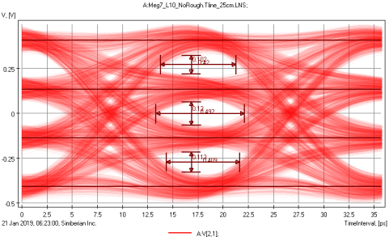
COM In Nutshell
>3 dB for pass threshold
>4 dB for excellent links
Peak Signal – includes all losses accounted in model and equalization
Peak SER Noise – includes losses, ISI, crosstalk and random noise with some assumptions and equalization
DIE A
Stripline or Microstrip Link
DIE B
Package
AC Caps
Package
PCB
Channel Operating Margin (COM) – single real number ideally for RA

Slide 13
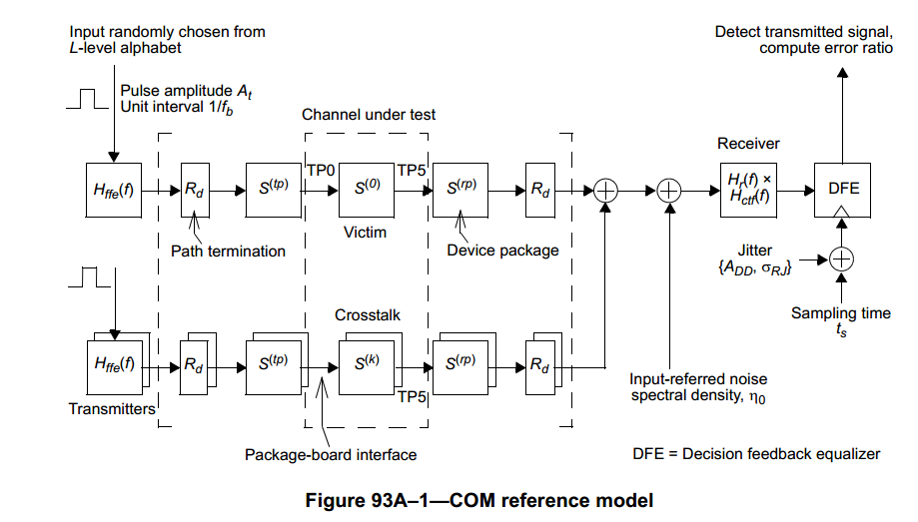
COM Base System Performance
TPa
TPb
TP0
TP5
What is needed to compute COM?
S-parameters computed or measured over sufficient bandwidth suitable for 112 Gbps PAM4 time domain conversion:
a) S-parameters of links with crosstalk from TP0 to TP5 if vendor or the reference package model is used;
b) S-parameters of links with crosstalk from TPa to TPb for analysis with package model;
2) COM script – Matlab script from IEEE P802.3ck group is used;
TP0-TP5
TPa
TPb

Slide 14
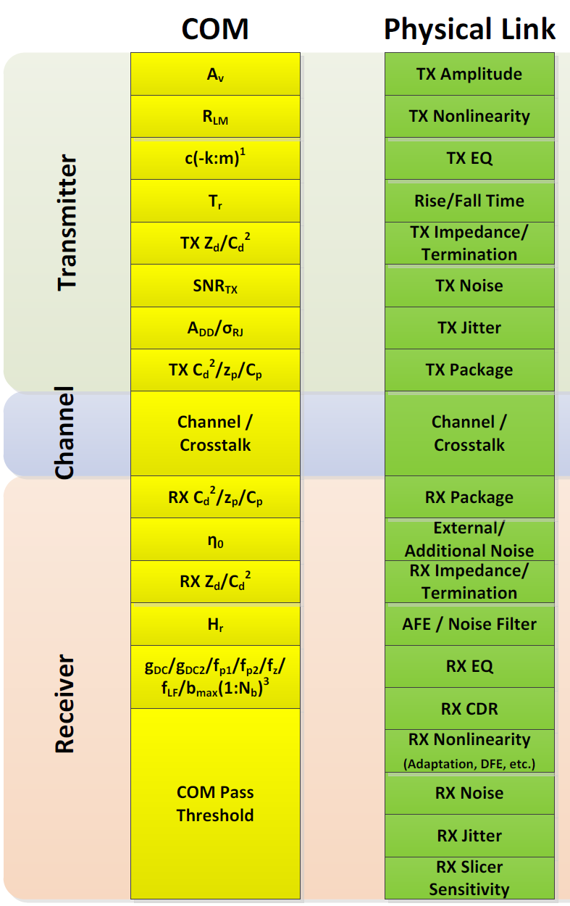
Other inputs to COM
Transmitter (Tx)
Voltage swing (Av)
Nonlinearity (R_LM)
Rise/Fall Time (Tr)
Jitter (sigma_RJ and A_DD)
Noise (SNR)
FFE tap ranges plus limits (c(k))
Receiver (Rx)
One-sided noise spectral density (eta_0)
Bandwidth limiting filter (f_r)
Reference CTLE (g_DC, f_z, f_p1, f_p2) and noise filter (g_DC_HP, f_HP_PZ)
Number of ideal DFE taps plus limits (N_b, b_max(n))
Detector error ratio (DER_0) related to forward error correction (FEC) choice
Termination resistor (R_d)
Most of the parameters are from the reference 802.03ck (C2C) script;
Equalization parameters are optimized by the reference script;
Number of DFE taps was 1 and 5;
Details and references in the paper…
H. Wu, M. Shimanouchi, M. P. Li, COM & IBIS-AMI How They Relate & Where They Diverge, DesignCon 2019

Slide 15
Interconnect System Modeling and Feature Selection
Major Signal Degradation Factors:
Thermal losses – dielectric and conductor effects
Reflections – characteristic impedance mismatch and discontinuities
Couplings - leaks and interference

Slide 16
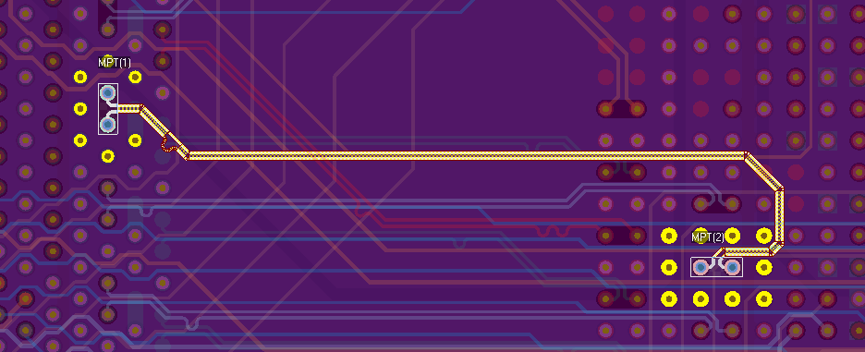
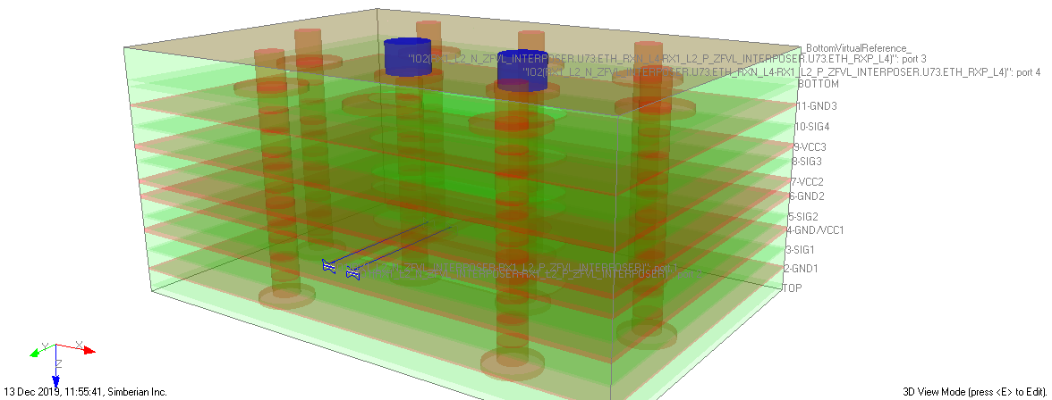
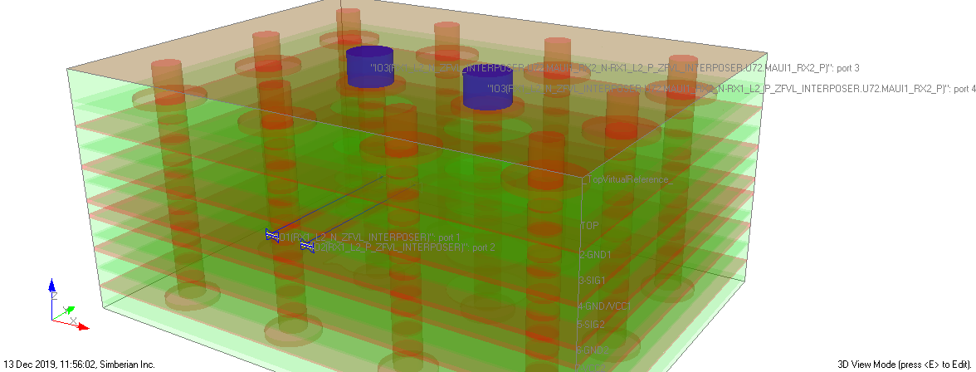
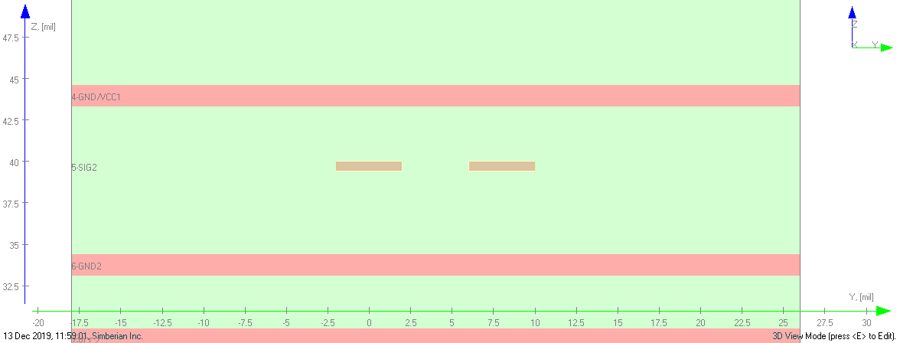
Extraction of channel S-parameters: 1D+3D decompositional approach
Tx
Tx Package (COM)
Rx Package (COM)
Rx
1D TLine
3D EM
3D EM
2D quasi-static

Slide 17
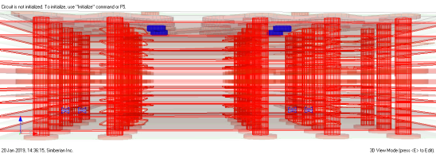
Models to compute S-parameters of links
1D models or transmission line models – Telegrapher’s equations
Modal or per unit length parameters for the Telegrapher's equations (Z, Y) are computed with static or quasi-static field solver (2D problems for Laplace's equations) or an electromagnetic fields solver (3D problems for Maxwell's equations)
Lines with coupling, multimodal waveguides, periodic structures can be accurately modeled as 1D
3D models or 3D full-wave models - everything described and solved with Maxwell's equations without any simplifications for 3D geometries or field components
Analysis of discontinuities such as via-holes, connectors or any type of transitions between uniform traces
1D+3D: Hybrid de-compositional analysis with transmission line models for traces (1D) and 3D models for discontinuities or transitions (Y. Shlepnev, EMC 2013)
The best technique for the serial interconnects under the localization condition This approach usually works for PCB and packaging problems with a relatively long traces, but may fail if trace segments are too short – complete 3D analysis is required in this case

Slide 18
Accuracy of 1D+3D de-compositional analysis
Accuracy depends on proper localization of every single element in the link
Broadband dielectric and conductor roughness models are identified (with GMS-parameters or SPP Light)
Very important for PCB – models must be statistical for 56-112 Gbps (see more A. Manukovsky, Y. Shlepnev, DesignCon 2019, EPEPS 2019), about time to start doing it for packages
Manufactured geometry adjustments are identified or statistical models are available
Electromagnetic solvers are formally validated with measurements using systematic approach (“sink or swim” for instance)
See more at M. Marin, Y. Shlepnev, DesignCon 2018, EMC 2018, Webinar #8
Other considerations: Ports consistency and de-embedding, boundary conditions,…

Slide 19
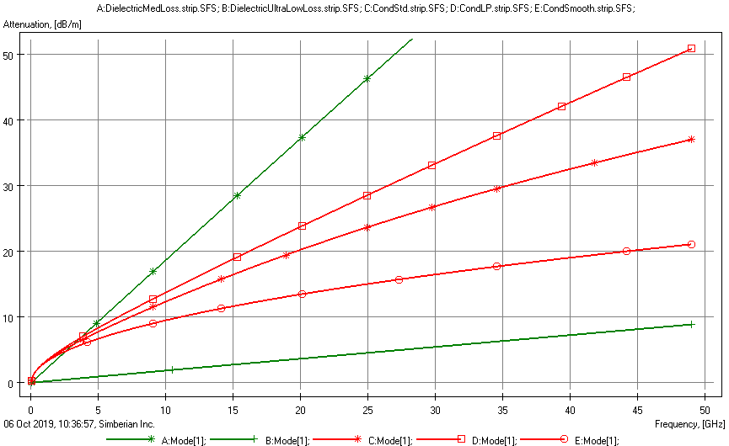
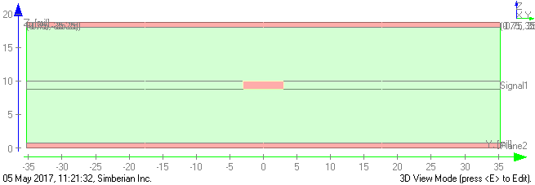
Thermal losses: dielectric and conductor
Medium loss (LT=0.01, FR408)
Dielectric from ultra-low loss (LT=0.001) to medium loss (LT=0.01); Use causal Wideband Model (Djordjevic-Sarkar) defined with 2 parameters (Dk and LT) at one frequency point;
Conductor and conductor roughness: use causal Huray-Bracken models defined with 2 parameters (SR and RF) with previously identified values;
Copper with HVLP surface, SR=0.14 um, RF=8.7
6x1.2 mil strip in dielectric with Dk=4.2 (50 Ohm, typical size)
Copper with STD/RTF surface, SR=0.4um, RF=2
Smooth copper
Ultra-Low loss (LT=0.001,Meg7)

Slide 20
Features affecting thermal losses and reflections due to impedance mismatch
Feature | Description
Ha | Height of dielectric layer above strips
Hb | Height of dielectric layer below strips
T | Strip thickness
W | Strip width in the middle of strip layer
S | Spacing between strips (middle)
EF | Strip etch factor – EF=0.5(Wtop-Wbot)/T
RR | Conductor resistivity relative to annealed copper
SR | Surface roughness in um for Huray-Bracken roughness model
RF | Surface roughness factor for Huray-Bracken roughness model
Dk | Dielectric constant at 1 GHz for Wideband Debye dielectric model
LT | Loss tangent at 1 GHz for Wideband Debye dielectric model
Length | Differential strip line length
Stripline segment (PKG and PCB)
Length
1
3
2
4
Select possible laminates – defines Ha, Hb, Dk, LT, RR, SR, fix EF;
Set S for strong or weak coupling; Compute W for about 10% and 5% deviation from Ztarget

Slide 21
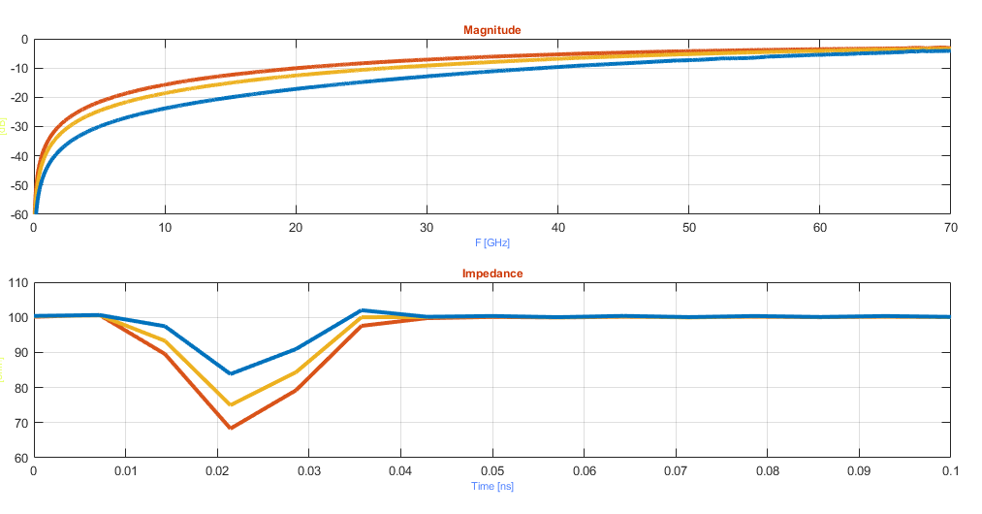
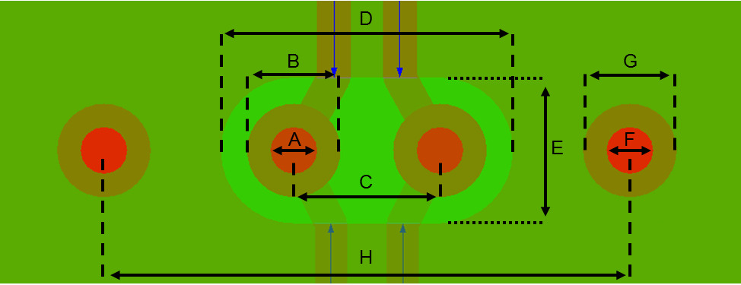
Reflections: PCB vias discontinuity
Example of model building and optimization
Reflection, dB
3D EM models (s4p): 3 cases
TDR, Ohm

Slide 22
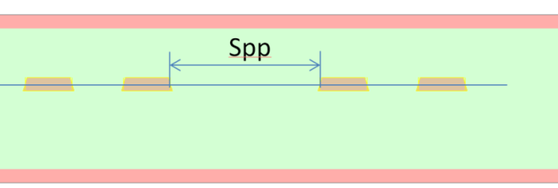
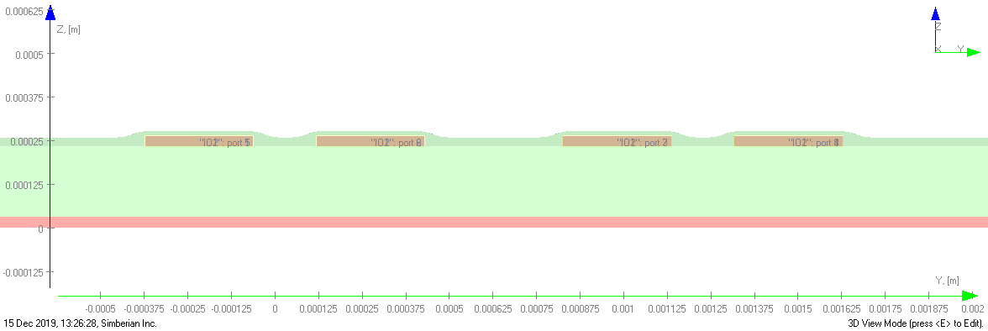
Features affecting coupling
Stripline or microstrip
2 coupled differential stripline or microstrip segments on PCB
Spp – diff. pair to pair separation
Lcp – length of coupled section
Stackup features - same as for differential pairs
Spp
All other types of couplings (localization breakout, mode conversion, multipath propagation,…) are either mitigated by design or ignored in this investigation
Example of features for xtalk investigation from MLKit of Simbeor SDK

Slide 23
ML Design Exploration Examples 112 Gb Chip to Chip Link
1) Simple 112 Gbps PCB link case
2) Realistic 112 Gbps link with PCB discontinuities and crosstalk

Slide 24
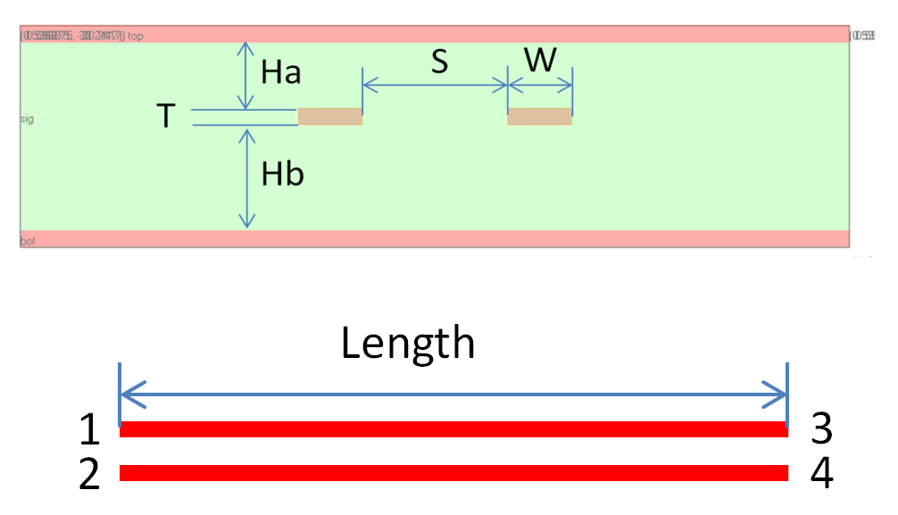
Simple 112 Gbps link case
DOE Table: 5760 cases
 | Feature
1 | Tx_PCB_TL_S (S/H) | 1 | 2 | 3
2 | Tx_PCB_TL_L (Length) [in] | 0.5 | 1 | 3 | 6 | 9 | 12
3a | PCB_Dk (Dk) | 2.8 | 3.2 | 3.5 | 3.8
3b | PCB_LT (LT) | 0.001 | 0.002 | 0.004 | 0.009
4 | PCB_TL_H (Ha,Hb) [mil] | 3 | 5 | 8 | 10
5 | PCB_Imp, [Ohm] | 85 | 90 | 95 | 100 | 105
6 | PKG_Len, [mm] | 1 | 5 | 12 | 31
Insertion Losses (dB) for some PCB links
+Reference package parameters, 1 tap DFE
Simulated with Simbeor SDK

Slide 25
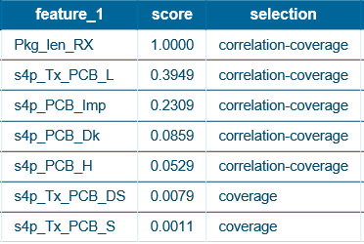
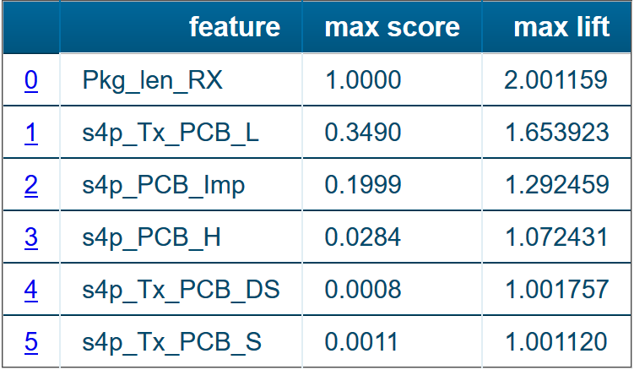
Simplest link RA results – long PKGs (12 and 31 mm)
What are the important features that impact the system behavior the most?
Results of ranking and basis procedures: strongest correlation to response and variability (coverage)
Single-range features maximizing quality
Positive: COM>=4
Negative COM<4
Package length is highly rated by both procedures – this is the most important element of the link

Slide 26
Simplest link– long PKGs (12 and 31 mm)
What are the ranges of each of the important features in which we are most likely to achieve desired system response?
Pkg_len_RX
Positive: COM>=4
Negative COM<4
 | range_1 | score | selection | Positive Out | Negative Out | Positive In | Negative In | Range Lift
1 | 31:Inf | 1.0 | correlation-coverage-target | 0 | 4319 | 2251 | 2063 | 2.001159
 | range_1 | score | selection | Positive Out | Negative Out | Positive In | Negative In | Range Lift
1 | 6:6 | 0.2184 | target | 1630 | 5563 | 621 | 819 | 1.653923
2 | 6:9 | 0.2674 | target | 1129 | 4627 | 1122 | 1755 | 1.495682
3 | 3:9 | 0.3490 | correlation-coverage-target | 628 | 3688 | 1623 | 2694 | 1.441859
s4p_Tx_PCB_L

Slide 27
Simple link: long packages (12 and 31 mm)
COM vs. Total Loss at Nyquist frequency – longer package is better
s4p_Tx_PCB_L
PCB Link Length
COM
Brown: PKG_Len=31mm
COM
PKG 31mm
12
10
8
6
COM > 3dB
4
COM > 3dB
2
0
COM < 3dB
COM < 3dB
PKG 12mm
Blue: PKG_Len=12mm
COM vs Loss for two package lengths and different PCB lengths
COM vs Loss for two package lengths
Total Loss, dB
Total Loss, dB

Slide 28
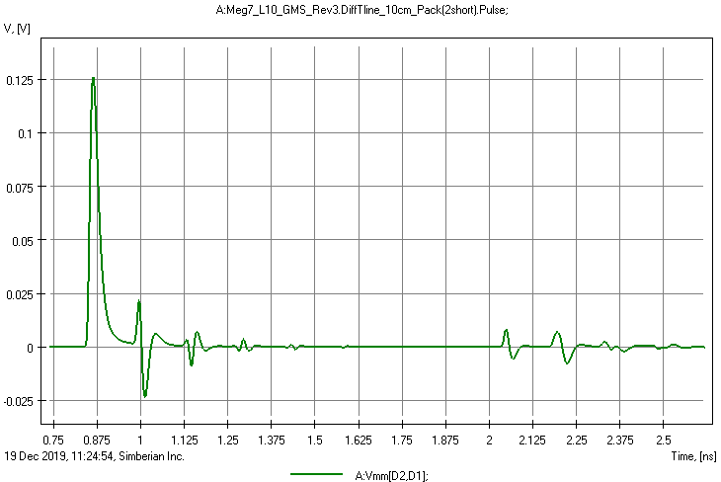
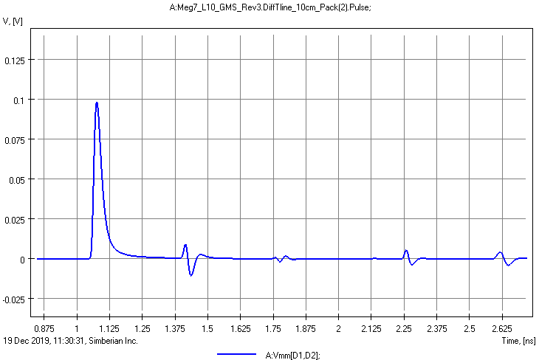
Why 12mm Rx package is a Challenge
Shorter package (12mm)
Longer package (31mm)
SSR (Tsymb=17.8571ps, Trise=4ps)
SSR (Tsymb=17.8571ps, Trise=4ps)
4in PCB link, IEEE 802.3ck reference package: Cd=120fF, Ls=120 pH Cb=30fF, Cp=90fF, Lp=12mm
4in PCB link, IEEE 802.3ck reference package: Cd=120fF, Ls=120 pH Cb=30fF, Cp=90fF, Lp=31mm
Reflections cause ISI
Reflections cannot be mitigated with 1 tap DFE!

Slide 29
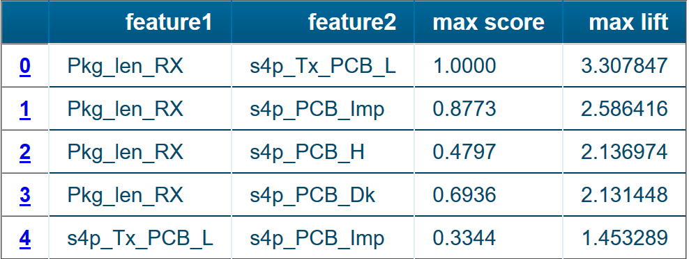
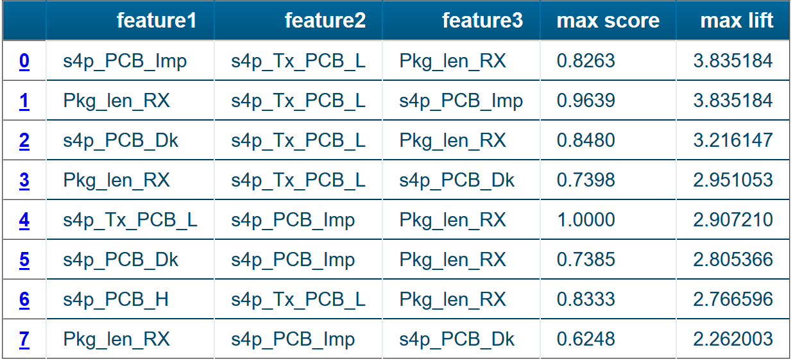
Simple link– long PKGs (12 and 31 mm)
What are the combinations of feature that impact the system behavior the most? (enabling us to achieve desired system response)
Important range-pair features
Important range triplet features
Positive: COM>=4
Negative COM<4
Combinations of features with package and PCB link length have highest lift – proper selection increases likelihood of success

Slide 30
Simple link RA results – long PKGs
What are the combinations of feature ranges that enable us to achieve desired system response? (maximizing quality )
 | s4p_PCB_Imp range_1 | s4p_Tx_PCB_L range_2 | Pkg_len_RX range_3 | score | selection | Positive Out | Negative Out | Positive In | Negative In | Range1 Lift | Range2 Lift | Range3 Lift | Triplet Lift
1 | -Inf:90 | 6:6 | 31:Inf | 0.3600 | target | 1963 | 6382 | 288 | 0 | 1.282095 | 1.653923 | 2.001159 | 3.835184
2 | -Inf:95 | 6:6 | 31:Inf | 0.4577 | target | 1822 | 6379 | 429 | 3 | 1.220420 | 1.653923 | 2.001159 | 3.808551
3 | -Inf:95 | 3:Inf | 31:Inf | 0.8263 | correlation-coverage | 888 | 6018 | 1363 | 364 | 1.220420 | 1.298165 | 2.001159 | 3.026842
Positive: COM>=4
Negative COM<4

Slide 31
Simple link: PCB link length effect
COM vs. Total Loss at Nyquist frequency -
Optimal link length is between 3 and 9 inches
PCB channel 6 inches along with 31mm package is the best option
COM
Brown: PKG_Len=31mm
COM > 3dB
COM < 3dB
Blue: PKG_Len=12mm
COM vs Loss for two package lengths and different PCB lengths (L)
L=0.5in
L=1in
L=3in
L=6in
L=9in
L=12in
Total Loss, dB

Slide 32
Simple link: PCB dielectric effect
COM
COM > 3dB
PCB Link Length
COM vs. Total Loss at Nyquist frequency -
Better dielectrics improve link quality for longer links
However not in every case it is beneficial to go for low Dk option
PKG_Len=12mm
COM < 3dB
COM vs Loss for different dielectrics and PCB lengths
PKG_Len=31mm
COM > 3dB
COM < 3dB
Dk=2.8
LT=0.001
Dk=3.2
LT=0.002
Dk=3.5
LT=0.004
Dk=3.8
LT=0.009
Total Loss, dB

Slide 33
Simple link: dielectric thickness effect
COM vs. Total Loss at Nyquist frequency
Thicker dielectrics improve link quality for longer links
However in links (below 9 in) thin dielectrics will provide similar performance
For short links (below 3 in) thin dielectric has an advantage
COM
COM > 3dB
PCB Link Length
PKG_Len=12mm
COM < 3dB
COM vs Loss for different diel. thickness and PCB lengths
PKG_Len=31mm
COM > 3dB
COM < 3dB
H=3mil
H=5mil
H=8mil
H=10mil
Total Loss, dB

Slide 34
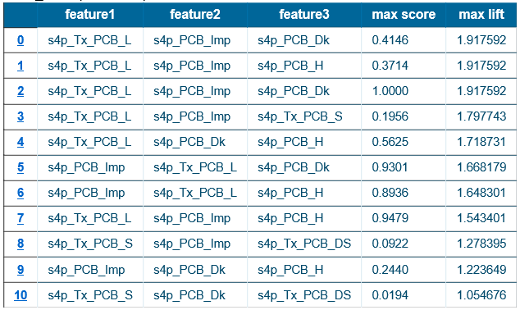
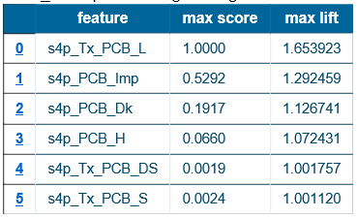
Simple link– short PKGs (1 and 5 mm)
What are the important features that impact the system behavior the most?
PKG length is not important
Lift is small – most of the cases pass 4 dB threshold
Lets ask the opposite question
Triplet range features
Single-range features
Positive: COM>=4
Negative COM<4
Positive: COM>=4
Negative COM<4

Slide 35
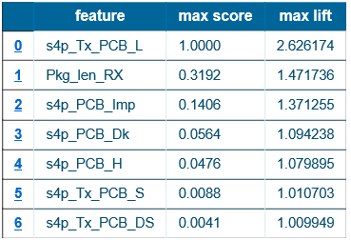
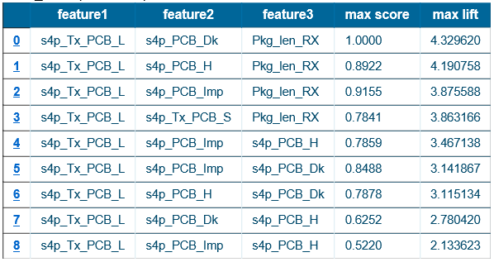
Simple link – short PKGs (1 and 5 mm)
What are the feature ranges where system is most likely to fail?
Ranking results are similar to the excellent system (COM>=4) for 12 and 31 mm PKGs case
High Lift scores
Single-range features
Important range triplet features
Positive: COM<3
Negative COM>=3

Slide 36
Simple link: short packages
COM vs. Total Loss at Nyquist frequency – shorter package is better
COM
Blue: PKG_Len=1mm
COM
PKG 1mm
PCB Link Length
Brown: PKG_Len=5mm
PKG 5mm
COM > 3dB
COM > 3dB
COM < 3dB
COM < 3dB
COM vs Loss for two package lengths
COM vs Loss for two package lengths and different PCB lengths
Total Loss, dB
Total Loss, dB

Slide 37
Realistic PCB link with crosstalk and discontinuities
DOE Table: 25920 cases
 | Feature
1 | Tx_PCB_TL_S (S/H) | 1 | 2 | 3
2 | Tx_PCB_TL_L (Length) [in] | 0.5 | 1 | 3 | 6 | 9 | 12
3a | PCB_Dk | 2.8 | 3.2 | 3.5 | 3.8
3b | PCB_LT | 0.001 | 0.002 | 0.004 | 0.009
5 | PCB_TL_H (Ha, Hb) [mil] | 3 | 5 | 8 | 10
6 | PCB_Imp [Ohm] | 85 | 90 | 95 | 100 | 105
7 | Tx_PCB_TL_DS (Spp) [mil] | 3 | 5 | 10
8 | SR [um] | 0.075 | 0
9 | PKG_Len [mm] | 5 | 12 | 31
Optimized discontinuities + reference package model
0.8*Length
0.2*Length
Simulated with Simbeor SDK

Slide 38
Realistic link S-parameters
Insertion Loss, dB
Reflection, dB

Slide 39
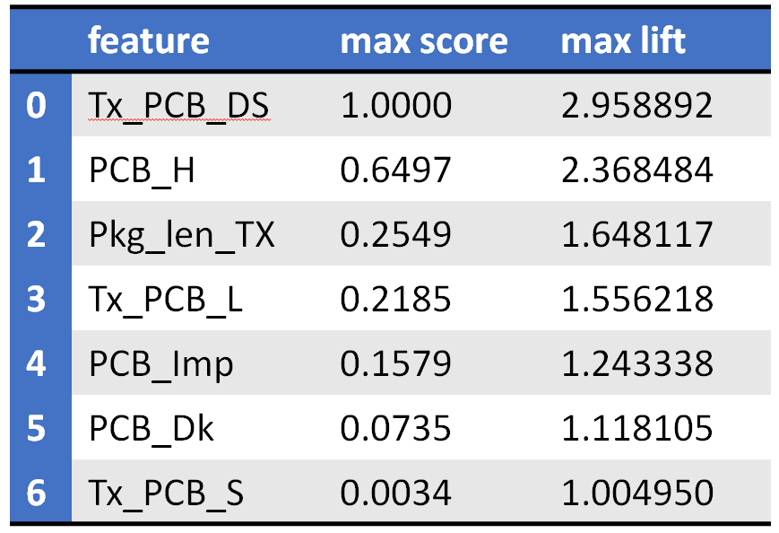
Realistic link with xtalk and 1 DFE tap
Most relevant features
Positive: COM>=3; Negative COM<3
 | feature_1 | score | selection
1 | Tx_PCB_DS | 1.0000 | correlation-coverage
2 | PCB_H | 0.6766 | correlation-coverage
3 | PCB_Imp | 0.1452 | correlation-coverage
4 | Tx_PCB_L | 0.1392 | correlation-coverage
5 | PCB_Dk | 0.0839 | correlation
6 | PCB_LT | 0.0839 | coverage
7 | Pkg_len_TX | 0.0508 | coverage
8 | PCB_SR | 0.0418 | coverage
9 | Tx_PCB_S | 0.0025 | coverage
Important single range features

Slide 40
Important single range features
Positive: COM>=3; Negative COM<3
Differential pair to pair separation single range
Dielectric thickness – two possible single ranges
Proper selection of differential pair to pair separation and dielectric thickness increases likelihood of success

Slide 41
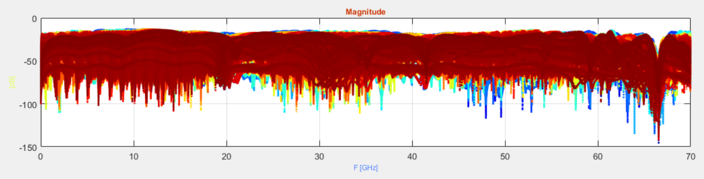
Realistic link crosstalk
FEXT, dB
NEXT, dB

Slide 42
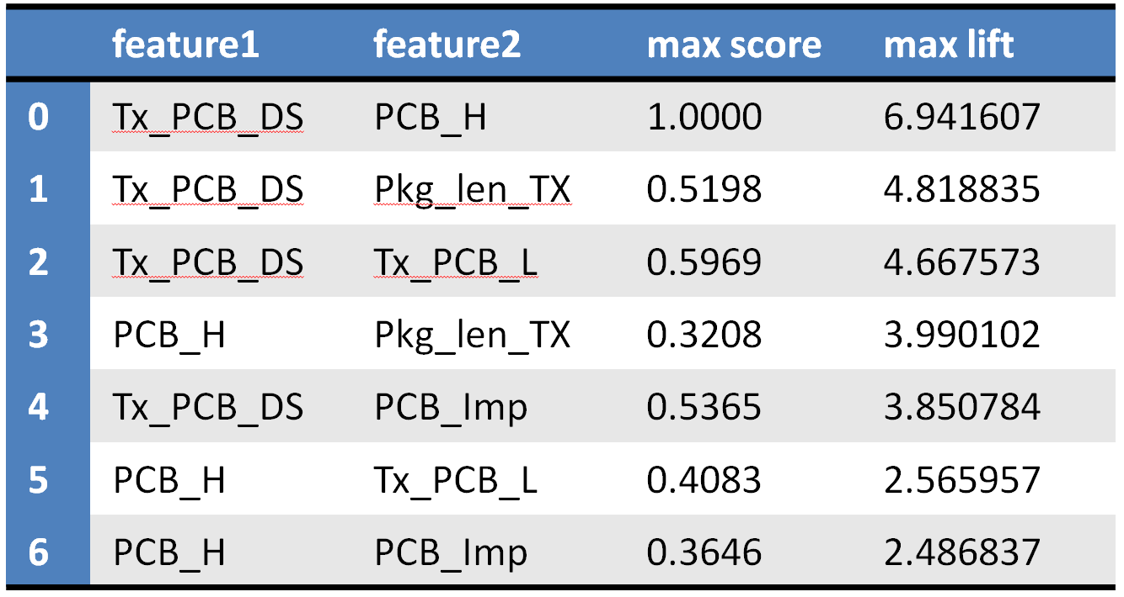
Important range-pair features
Positive: COM>=3; Negative COM<3
The most important pairs, high Lift
Pair ranges for differential pair to pair separation and dielectric thickness

Slide 43
Dielectric thickness and pair to pair separation effect
COM, dB
COM, dB
COM > 3dB
COM < 3dB
Total Loss, dB

Slide 44
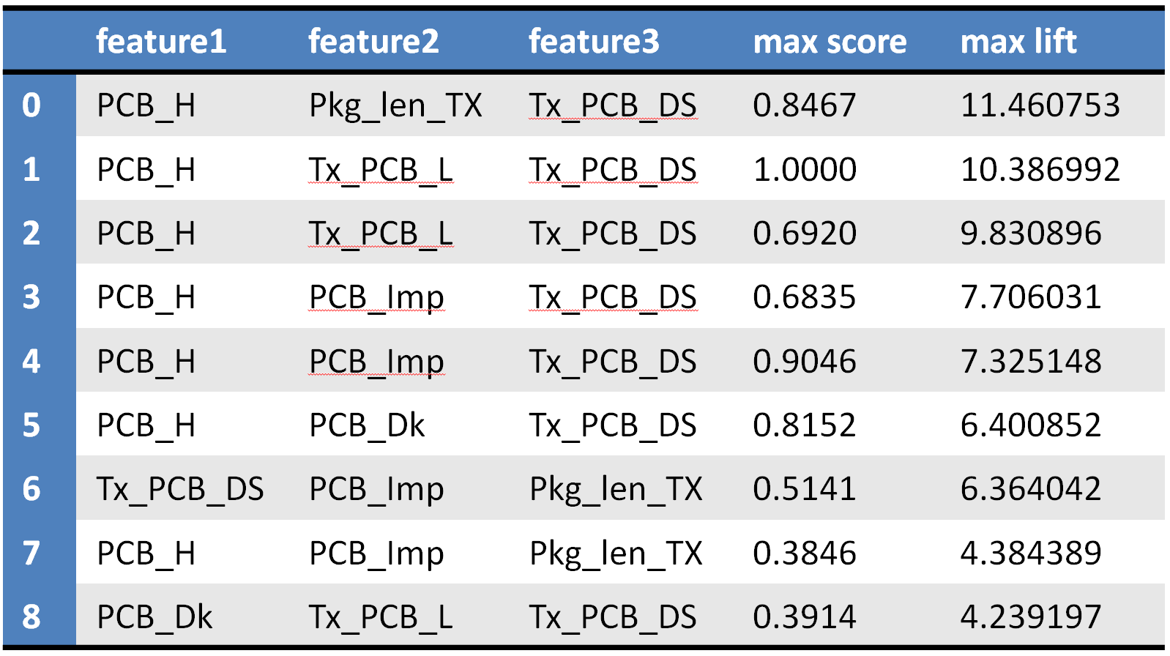
Important range triplets features
Positive: COM>=3; Negative COM<3
The most important triplets
Triplet ranges for dielectric thickness, package length and pair to pair separation.
Triplet ranges for dielectric thickness, PCB link length and pair to pair separation.

Slide 45
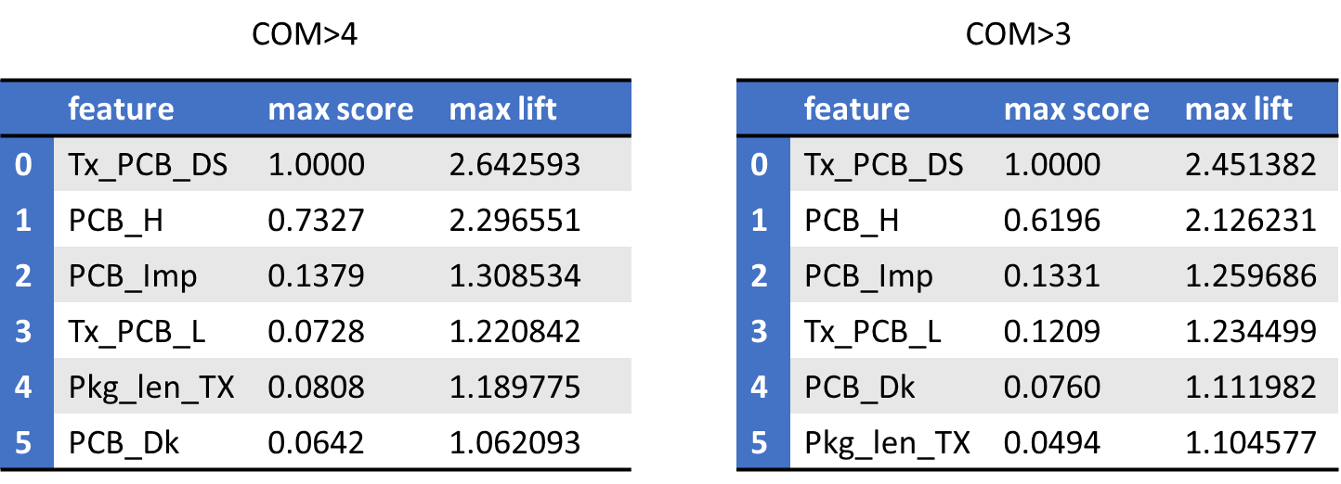
Realistic link with xtalk and 5 DFE taps
Important single range features
Excellent
Compliant
Package length is not so important with more taps!

Slide 46
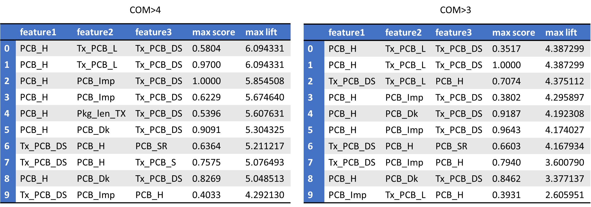
Realistic link with xtalk and 5 DFE taps
Important range triplets features
Excellent
Compliant
Package length is not even in the triplets for COM > 3dB!

Slide 47
Conclusion
Practical application of a ML based method to identify the parameters with the greatest effect on 112 Gbps system response is demonstrated
Initial set of features (length, thickness, dielectric,…) is identified with some knowledge about the features contributing to signal degradation
The rest of the process is a completely automated design exploration with the ML algorithms – no expert knowledge is required
It can be used as a decision support tool for system architect, Si designer, SI Engineer,…

Slide 49
Backup slides

Slide 50
Couplings: Leaks and Interference
Coupling type | Model
Crosstalk – leaks and interference in parallel traces | INCLUDE
Via localization breakout – leaks and interference and through parallel planes and between vias | Localize vias up to 40-50 GHz and do not simulate via coupling
Couplings through slots and cutouts in reference planes | Prohibit in layout
Modal transformations in diff. pairs (aka skew) – bends, asymmetry in routing, FWE | Mitigate with proper length compensation – do not simulate
Multipath propagation, radiation, EMI, EMC,… | Suppress with localization – do not simulate

Slide 51
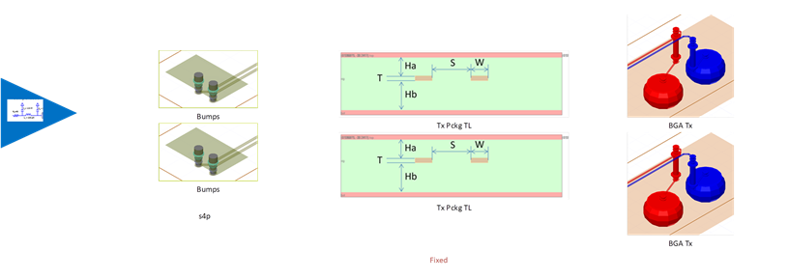
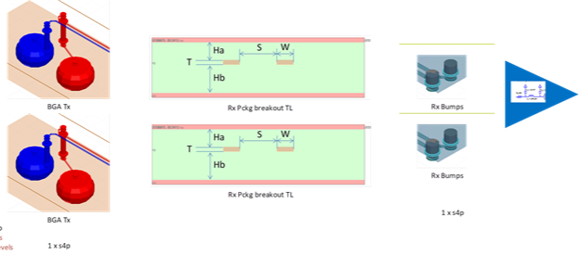
Chip-to-Chip (C2C) de-composition
Tx PKG
Rx PKG
Tx
Bumps
Balls
Rx
PCB
Rx PKG line segment
Rx PKG line segment
AC Caps
BGA-PCB Vias
PCB Vias
PCB Vias
BGA-PCB Vias
PCB coupled line segment
PCB coupled line segment

Slide 52
Simplest link: impedance effect
COM vs. Total Loss at Nyquist frequency – lower impedance is better
COM
PKG 31mm
PCB Imp
COM
PKG 31mm
ERL
COM > 3dB
COM > 3dB
COM < 3dB
COM < 3dB
PKG 12mm
PKG 12mm
COM vs Loss for two package length and different PCB impedances
COM vs Loss for two package lengths and different ERLs
Total Loss, dB
Total Loss, dB

