Slide 1
Unified form for conductor roughness correction coefficients
Yuriy O. Shlepnev
Simberian Inc.

Slide 2
Overview
Introduction
Roughness Correction Coefficients (RCCs)
Unified 2-parameter form
Additive and multiplicative extensions
Commonly used RCCs in the unified form
Inductive effect of roughness
Practical examples
Conclusion

Slide 3
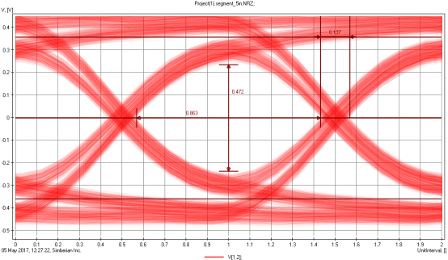
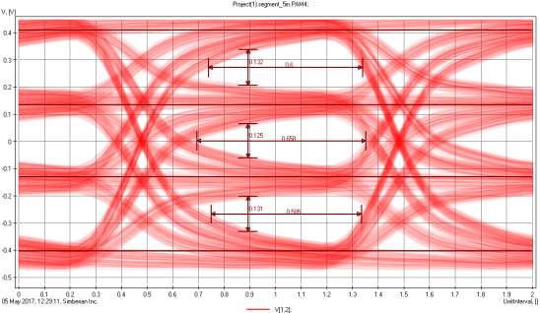
Printed Circuit Boards (PCBs)
Copper interconnects in layered dielectrics
System-level integration/packaging at relatively short distances (up to ~ 0.5 m)
Best bps/volume
Good bps/Watt – beats optical
Best bps/$ - beats optical & cables + conn.
Data rate can be extended up to 100 Gbps (NRZ) or 200 Gbps (PAM4)
Requires understanding and proper selection of laminate dielectrics, copper foil and fabrication process
Requires broadband dielectric and conductor surface roughness modeling
We have to be prepared to simulate rough copper interconnects well beyond 100 GHz…
100 Gbps – 6 mil, 5 inch strip
200 Gbps – 6 mil, 5 inch strip
More in “Material World” tutorial and “Laminate Material Characterization” webinar…

Slide 4
Rough copper bottleneck
Copper made rough to stick to laminate dielectric and prevent the delamination
Rolled “smooth” copper roughened by copper foil manufacturers and by PCB manufacturers (oxide treatment)
Electrodeposited copper is rough on one side (mate) and further roughened by PCB manufacturer on the drum (shiny) side
Narrow rough copper traces is the major obstacle for increase of communication speed on PCBs
Low-loss homogeneous dielectrics are available, broadband models can be constructed from the specs data (Dk and LT at one or multiple frqs)
Practically nothing on copper foil datasheets can be used to build broadband models (Ra/Sa is not sufficient, all other numbers are practically irrelevant)
To have analysis to measurement correlation at frequencies above 3-5 GHz, copper roughness models must be defined and identified

Slide 5
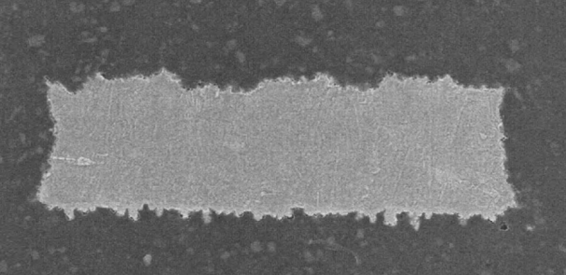
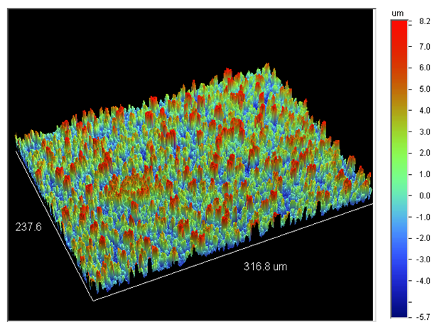
Roughness models
Direct electromagnetic analysis is simply not possible or very approximate
Differential Extrapolation Roughness Measurement (Koledintseva, Rakov,…)
Effective Roughness Dielectric Layer (Koledintseva, Koul,…)
Roughness Correction Coefficients (RCC):
Hammerstad model (Hammerstad, Jensen)
Bushminskiy’s model (Bushminskiy, Yakuben,…)
Groiss model (Groiss, Bardi,…)
Stochastic models (Sanderson, Tsang,…)
Hemispherical model (Hall, Pytel,..)
Huray’s snowball model (Huray,…)
Modified Hammerstad (Shlepnev, Nwachukwu)
Causal Huray model (Bracken)
Cross-section
Profilometer
How to get all that models into software?
See some references in the paper and at: Y. Shlepnev, C. Nwachukwu, Practical methodology for analyzing the effect of conductor roughness on signal losses and dispersion in interconnects, DesignCon2012

Slide 6
Unified 2-parameter form for six common roughness correction coefficients
“skin depth”
RF>1 – Roughness Factor – maximal increase in loss due to roughness (common for all models);
SR – Surface Roughness parameter – defines roughness onset frequency, different for different RCCs;
- Roughness Transition Function (from 0 to 1), different for different RCCs;
Hammerstad (RF=2) and Modified Hammerstad (RF)
Bushminskiy aka Simbeor Original
Groiss (RF=2) and Modified Groiss (RF)
Hemispherical (diverges at high frq)
Huray snowball (1-ball case or “cannonball”)
Causal Huray aka Huray-Bracken

Slide 7
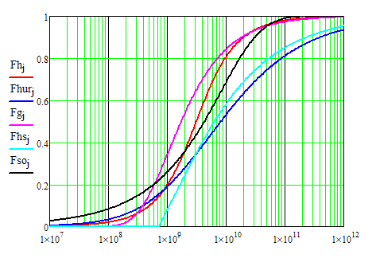
Comparison of roughness transition functions
SR=1 um for all models, except Hemispherical
SR=2 um for Hemispherical
Hammerstad
Groiss
Huray
Bushminskiy
Hemispherical
Frequency, Hz
All are real – are the final models causal?

Slide 8
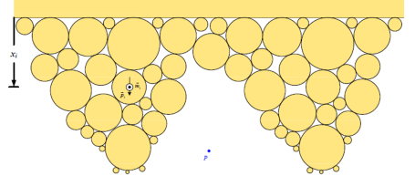
Additive and Multiplicative extensions
Additive – multiple bumps or balls at the same level
Multiplicative – fractal-type surface
First Additive approach is Huray “multi-ball” model:
P. G. Huray, O. Oluwafemi, J. Loyer, E. Bogatin and X. Ye, "Impact of Copper Surface Texture on Loss: A Model that Works," in DesignCon 2010 Proceedings, Santa Clara, CA, 2010.
First multiplicative approach is the extension of the Hemispherical model suggested in: Y. Chu, Method for modeling conductor surface roughness, US Patent #8527246, 2013.

Slide 9
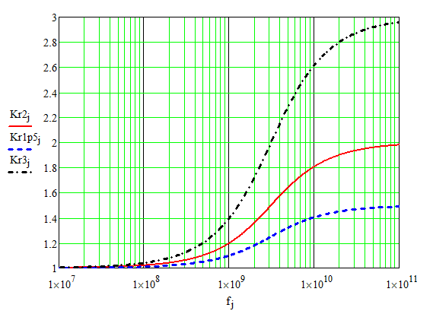
Multilevel Modified Hammerstad RCC
Multiplicative form:
~ root mean square peak-to-valley distance (SR for level i)
RFi - roughness factor, defines maximal growth of losses due to metal roughness (increase of surface at level i)
Conductor skin-depth
RF=3
Plane wave outside
RF=2 – original Hammerstad
RF=1.5
“Absorption” by the surface
Bumps are much smaller than wavelength!
Frequency, Hz
1-level (i=1) model with RF=2 is proposed in E.O. Hammerstad, Ø. Jensen, “Accurate Models for Microstrip Computer Aided Design”, IEEE MTT-S Int. Microwave Symp. Dig., p. 407-409, May 1980.
1-level (i=1) modified model with RF is proposed in Y. Shlepnev, C. Nwachukwu, Roughness characterization for interconnect analysis. - Proc. of the 2011 IEEE Int. Symp. on EMC, Long Beach, CA, USA, August, 2011, p. 518-523

Slide 10
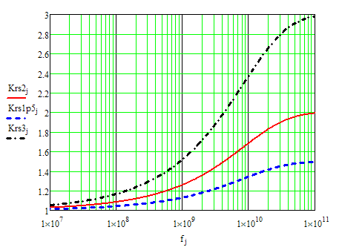
Multilevel Bushminskiy model
Multiplicative form:
~ root mean square peak-to-valley distance (SR for level i)
RFi - roughness factor, defines maximal growth of losses due to metal roughness (increase of surface at level i)
Conductor skin-depth
Plane wave outside
RF=3
RF=2
“Absorption” by the surface
RF=1.5
Bumps are much smaller than wavelength!
Frequency, Hz
1-level model (i=1) is published in Russian at: Бушминский И.П., Гудков А.Г., Якубень Л.Н. Потери в несимметричной микрополосковой линии. / Вопросы радиоэлектроники.- М.: Радиотехника.- 1982.-Вып. 2.- С. 73-87.

Slide 11
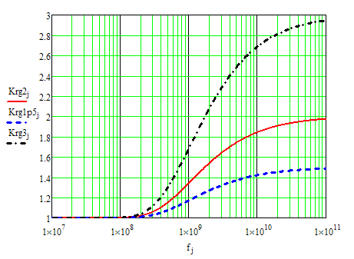
Multilevel Modified Groiss model
Multiplicative form:
~ root mean square peak-to-valley distance (SR for level i)
RFi - roughness factor, defines maximal growth of losses due to metal roughness (increase of surface at level i)
Conductor skin-depth
Plane wave outside
RF=3
RF=2 – original Groiss
“Absorption” by the surface
RF=1.5
Bumps are much smaller than wavelength!
Frequency, Hz
1-level model (i=1) with RF=2 is proposed in: S. Groiss, I. Bardi, O. Biro, K. Preis and K.R. Richter, Parameters of Lossy Cavity Resonators Calculated by Finite Element Method, IEEE Transaction on Magnetics, Vol.32, No.3, 1996, p. 894-897.
1-level model with RF=2 is the Groiss model used in HFSS

Slide 12
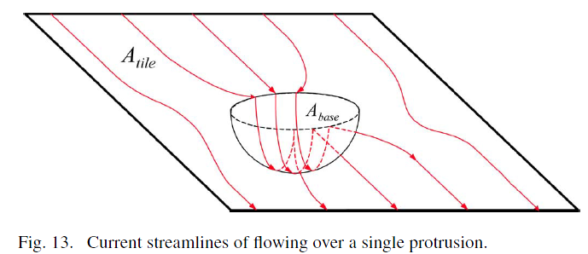
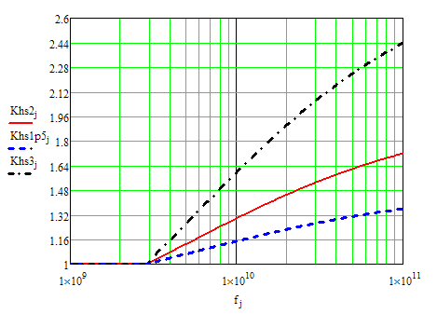
Multilevel Hemispherical model
S. Hall, S. G. Pytel, P. G. Huray,D. Hua, A. Moonshiram, G. A. Brist, E. Sijercic, “Multigigahertz Causal Transmission Line Modeling Methodology Using a 3-D Hemispherical Surface Roughness Approach”, IEEE Trans. On MTT, vol. 55, No. 12, p. 2614-2623, Dec. 2007
Unified multi-level form (multiplicative):
RFi - roughness factor, defines maximal growth of losses due to spheres with radius ri at level i (RFmax = 1+PI/2 – physical limit);
ri – sphere radius at level i (SRi parameter in Simbeor);
RF=3
Roughness factor and Atile in the original equation:
RF=2
ri – shpere i radius;
Atile_i – tile area at level i;
RF=1.5
Sphere radius to Rough and Bbase (ADS):
Roughness Factor (RF) and radius and Dpeaks (ADS):
Frequency, Hz

Slide 13
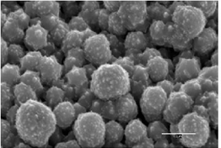
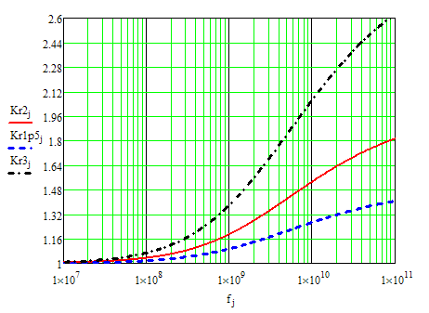
Multi-ball Huray snowball model
Losses estimation for conductive sphere are used to derive equation for multiple spheres:
Additive model – no levels!
P.G. Huray, The foundation of signal integrity, 2010
Amatte/Ahex can be accounted for by change of resistivity;
2-parameter addtive version of Huray Snowball model:
RF=3
RF=2
RFi - roughness factor, defines maximal growth of losses due to all balls with radius ri;
ri – ball radius (SRi parameter in Simbeor);
RF=1.5
Roughness factor and the original equation:
ri – ball i radius;
Ni – number of balls with radius ri;
Roughness Factor (RF) and Hall-Huray Surface Ratio (sr):
sri – Hall-Huray Surface Ratio in HFSS;
Frequency, Hz

Slide 14
Use of roughness correction coefficients in simulations
Adjust t-line attenuation in propagation constant:
Adjust conductor internal impedance (static t-line models):
Adjust Surface Impedance or Schukin-Leontovich BC:
Adjust differential conductor impedance operator (Zcs):
“skin depth”
at high frequencies converges to diagonal
Ksr is the diagonal matrix with RCC for each area of the conductor surface
Real Kr increases the real and imaginary parts of impedance keeping Wheeler’s rule
Only Huray-Bracken model has complex Kr and increases the imaginary part more – it is causal, but breaks the Wheeler’s rule

Slide 15
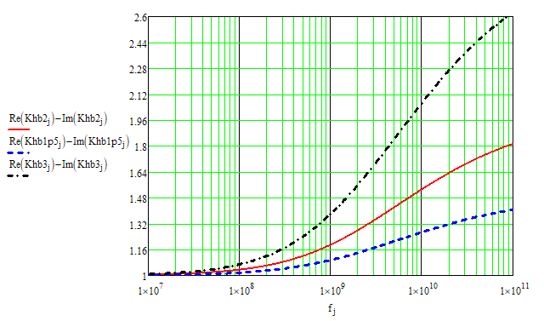
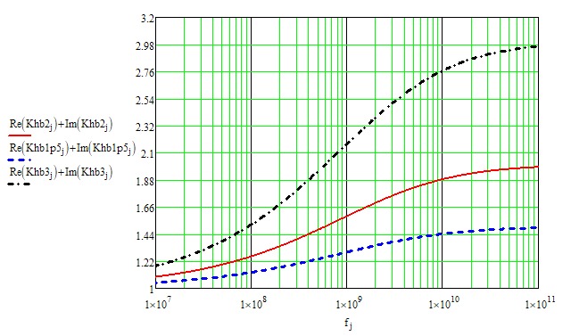
Causal Huray-Bracken model
J. E. Bracken, A Causal Huray Model for Surface Roughness, DesignCon 2012
Makes SIBC causal!
RFi - roughness factor, defines maximal growth of losses due to all balls with radius ri;
ri – ball radius (SRi parameter in Simbeor);
Conductor losses (same as in Huray model)
Additional conductor inductance
RF=3
RF=3
RF=2
RF=2
RF=1.5
RF=1.5
Frequency, Hz
Frequency, Hz

Slide 16
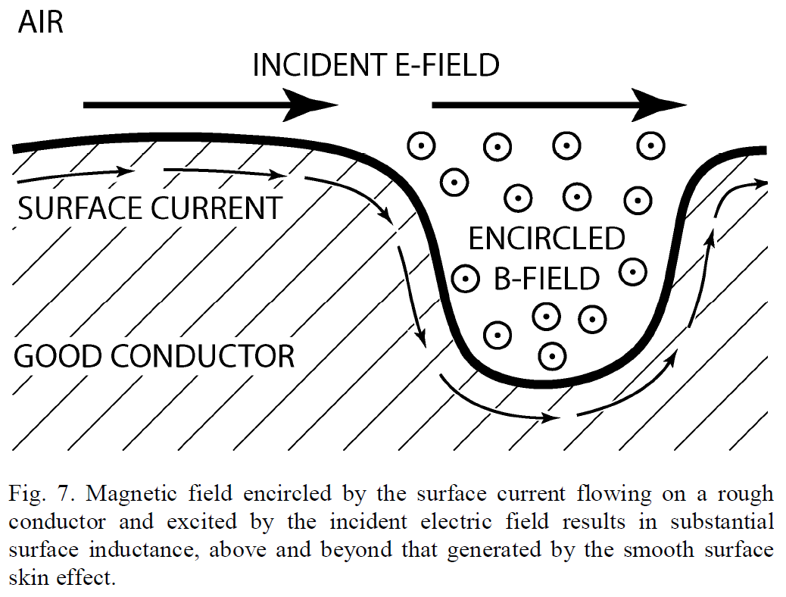
The effect of roughness
CAPACITIVE?
TWS foil with sharp spikes
A. Deutsch, et al, Accuracy of Dielectric Constant Measurement Using the Full-Sheet-Resonance Technique IPC-T650 2.5.5.6, , EPEPS 2002 p. 311-314
A. Albina at al., Impact of the surface roughness on the electrical capacitance, Microelectron. J. 37 (2006) 752-758.
Y. Shlepnev, C. Nwachukwu, Roughness characterization for interconnect analysis, IEEE Symp. on EMC 2011, p. 518-523.
OR INDUCTIVE?
A. F. Horn ; J. W. Reynolds ; J. C Rautio Conductor profile effects on the propagation constant of microstrip transmission lines – In Proc. of IEEE MTT-S International Microwave Symp., 2010, p. 868-871.
Let’s fact check it with the electromagnetic analysis…

Slide 17
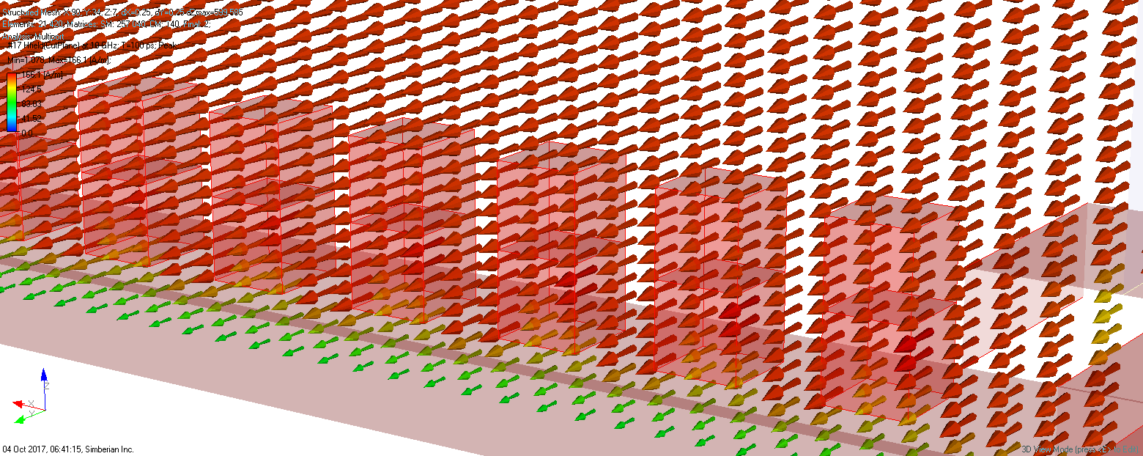
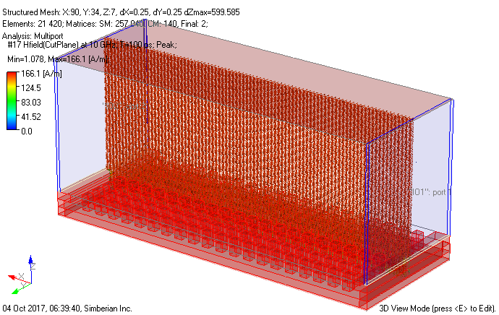
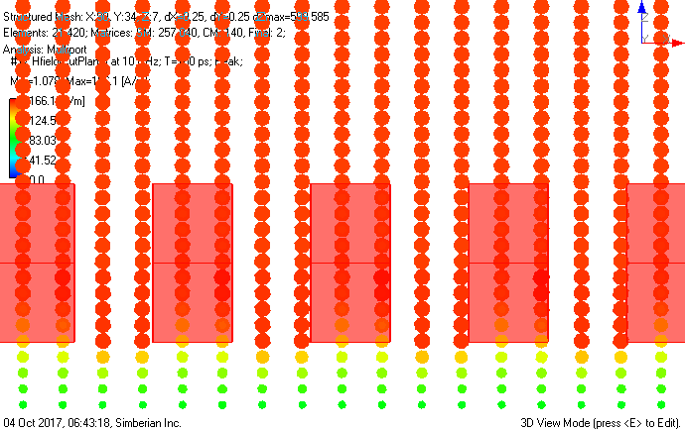
Roughness model with posts in PPW
Cut plane along the PPW through the posts
Magnetic field intensity [A/m]
Peak values at 10 GHz
Parallel-plate waveguide with one ideal conductor and another with 1 um posts (0.5 by 0.5 um) at 0.5 um distance
Uniform H inside and between the posts
Computed with Simbeor THz

Slide 18
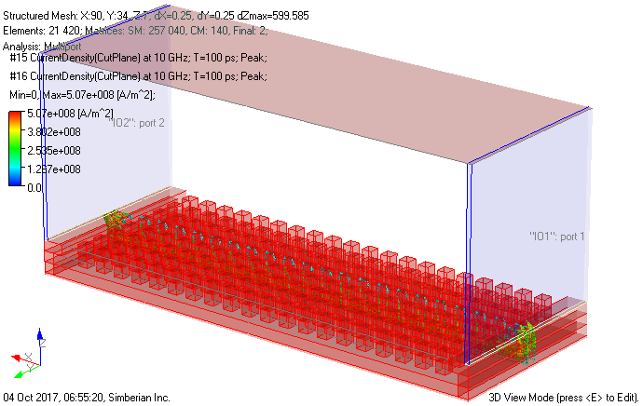
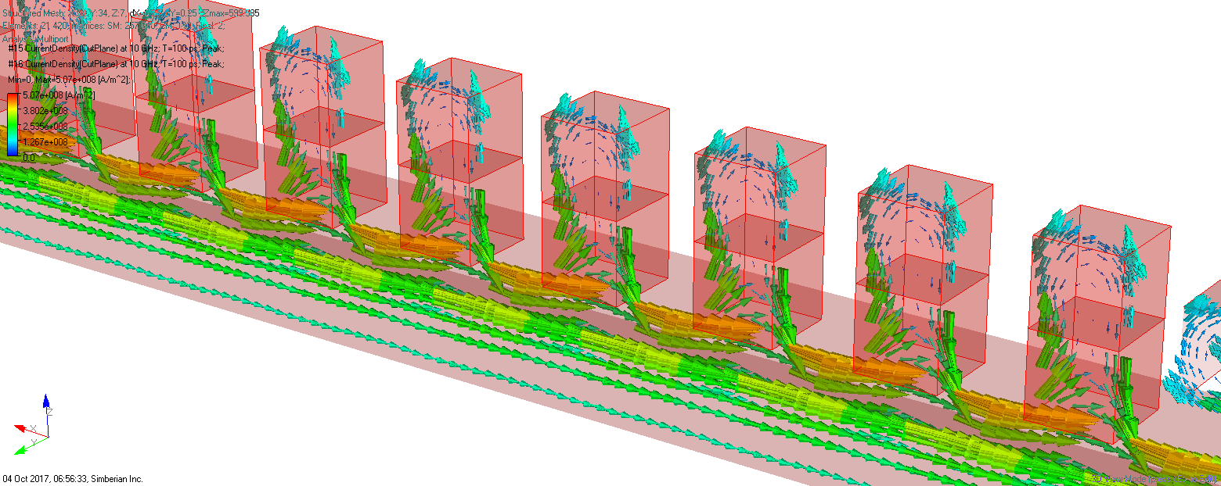
Roughness model with posts in PPW
Parallel-plate waveguide with one ideal conductor and another with 1 um posts (0.5 by 0.5 um) at 0.5 um distance
Cut planes along the PPW through the posts and between the posts
Current flow density [A/m^2]
Peak values at 10 GHz
Larger currents at the bottom and between the posts
Smaller currents in the “valleys”
Computed with Simbeor THz

Slide 19
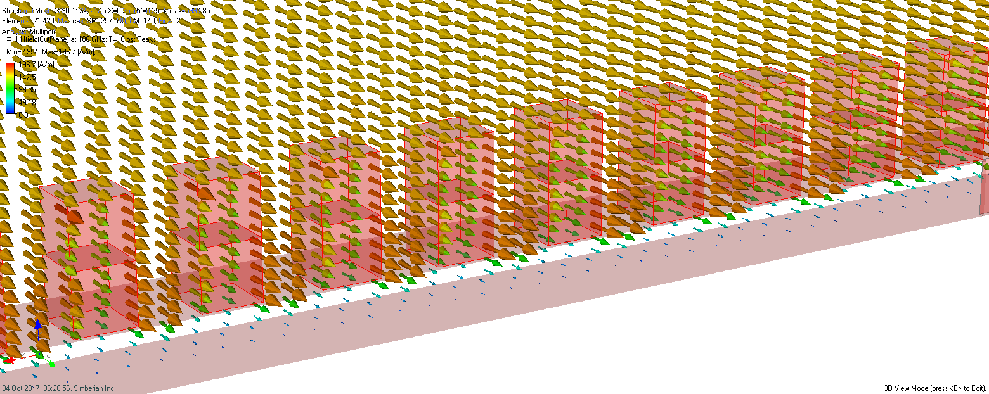
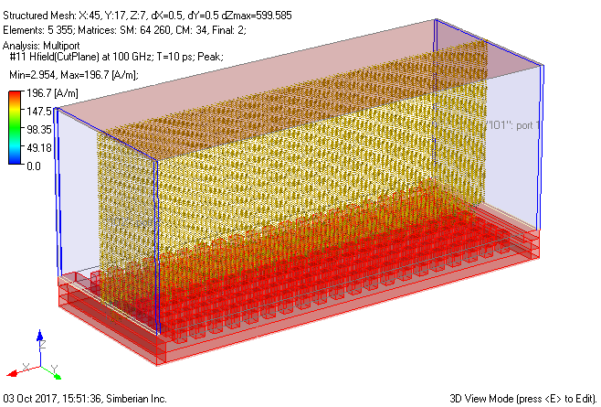
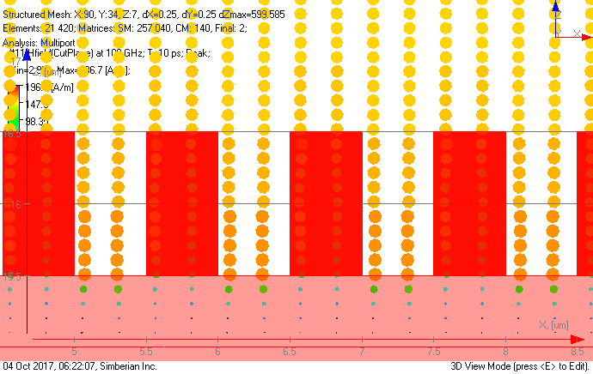
Roughness model with posts in PPW
Cut plane along the PPW through the posts
Magnetic field intensity [A/m]
Peak values at 100 GHz
Parallel-plate waveguide with one ideal conductor and another with 1 um posts (0.5 by 0.5 um) at 0.5 um distance
Larger H between the posts
Smaller H inside the posts
Computed with Simbeor THz

Slide 20
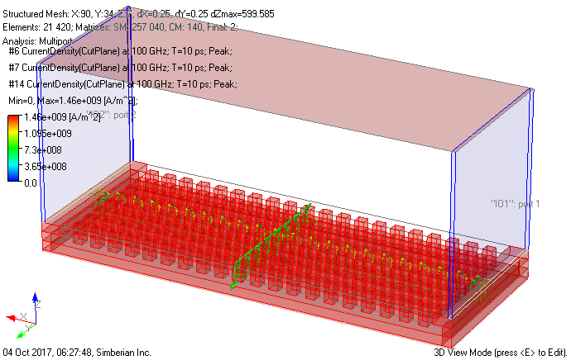
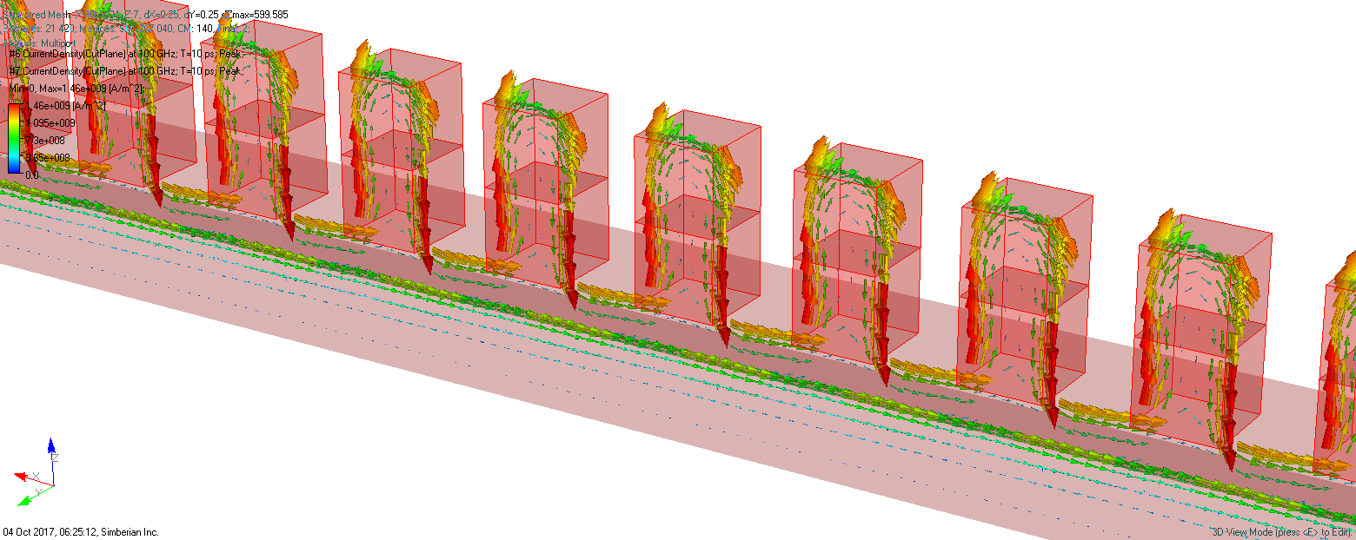
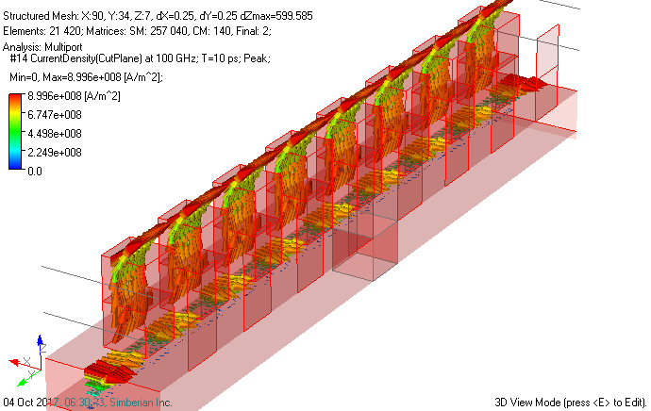
Roughness model with posts in PPW
Cut planes along the PPW through the posts and between the posts
Current flow density [A/m^2]
Peak values at 100 GHz
Parallel-plate waveguide with one ideal conductor and another with 1 um posts (0.5 by 0.5 um) at 0.5 um distance
Large currents on vertical walls normal to propagation direction (at the bottom of the posts)
Smaller currents in the “valleys”
Smaller currents on sides parallel the propagation direction
Computed with Simbeor THz

Slide 21
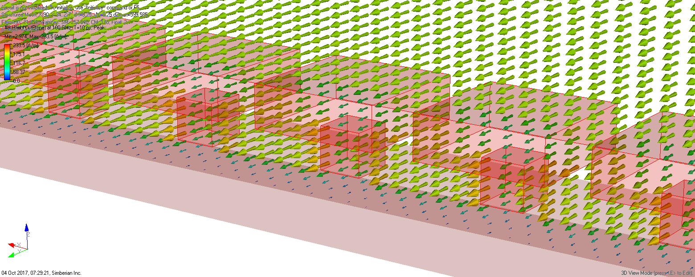
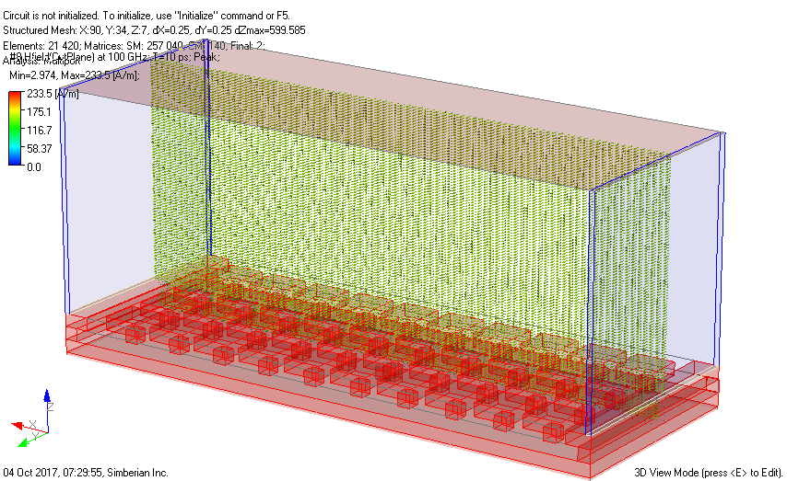
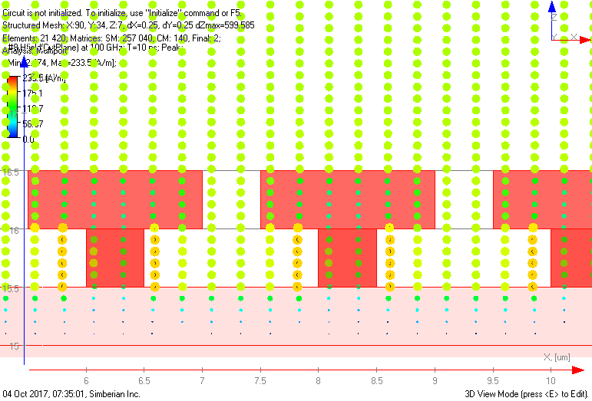
Roughness model with “mushrooms” in PPW
Cut plane along the PPW through the posts
Magnetic field intensity [A/m]
Peak values at 100 GHz
Parallel-plate waveguide with one ideal conductor and another with 1 um “mushrooms” (1.5 by 1.5 um cap, 0.5 um stem) at 0.5 um distance
Larger H between the “mushrooms”
Smaller H inside the “mushrooms”
Computed with Simbeor THz

Slide 22
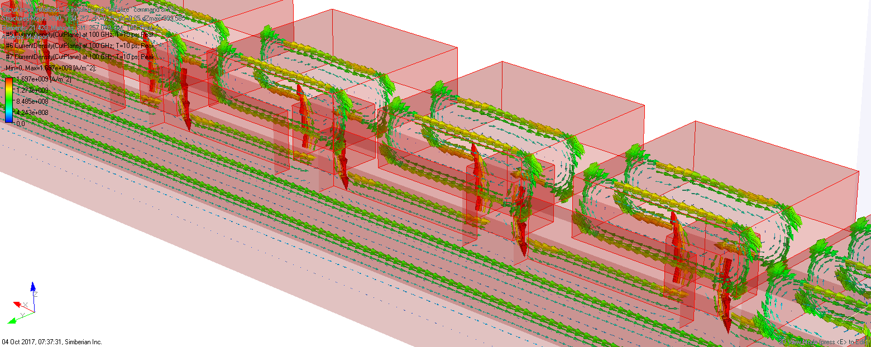
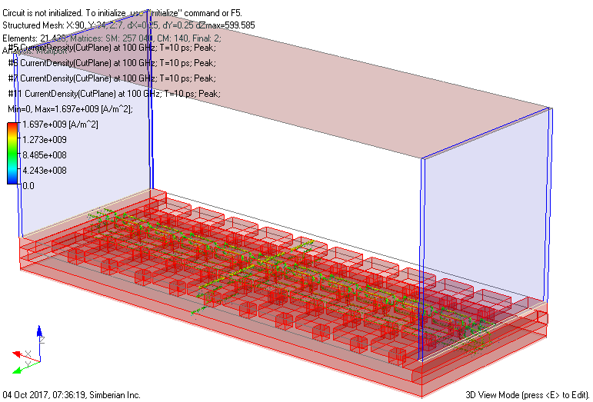
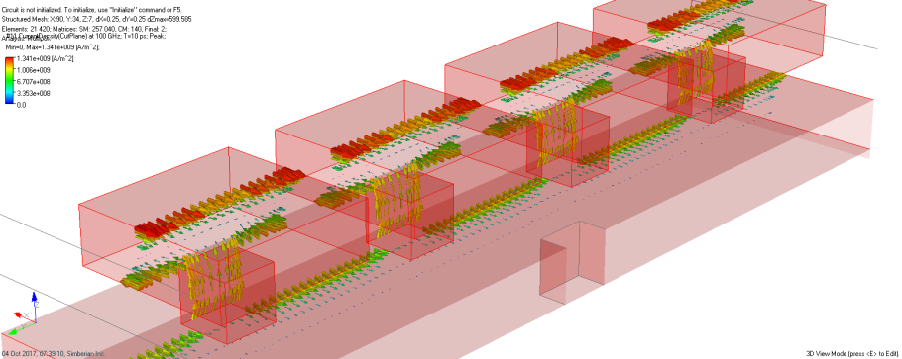
Roughness model with “mushrooms” in PPW
Parallel-plate waveguide with one ideal conductor and another with 1 um “mushrooms” (1.5 by 1.5 um cap, 0.5 um stem) at 0.5 um distance
3 cut planes along the PPW through the “mushrooms” and between
Current flow density [A/m^2]
Peak values at 100 GHz
Currents are on both sides of “cap” in opposite directions
Computed with Simbeor THz

Slide 23
“Mushrooms” in PPW – current flow density at 3 cut planes (between, through cap and stem)
Animation at 100 GHz over one period

Slide 24
“Mushrooms” in PPW – magnetic field intensity in cut plane through cap (additional inductance)
Animation at 100 GHz over one period

Slide 25
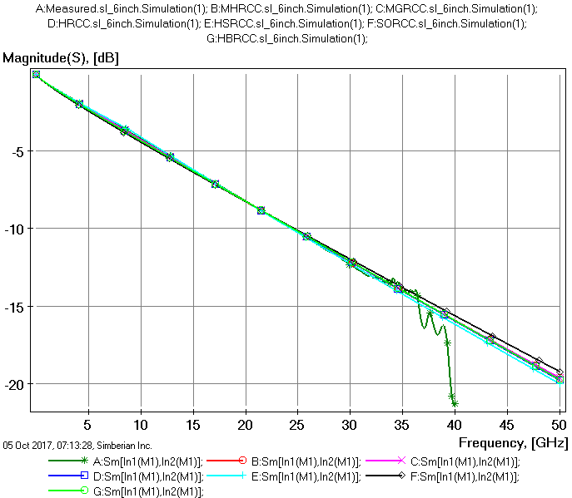
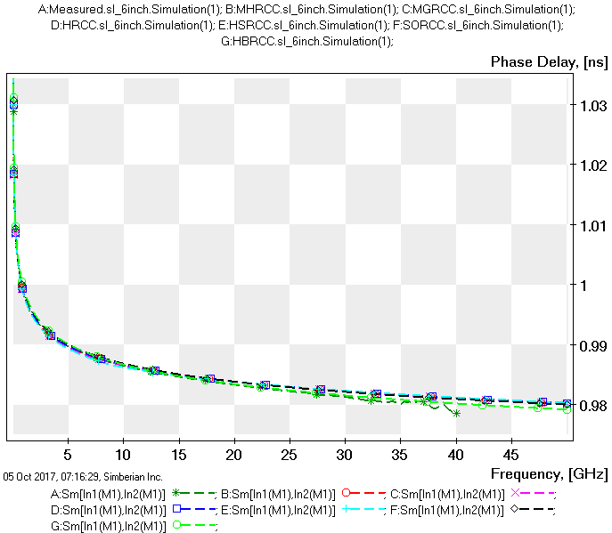
Roughness model identification with measurements
Identification with GMS-parameters for CMP-28 channel modeling platform from Wild River Technology – uses S-parameters of 2 line segments
GMS Phase Delay:
Measured – green *
MHRCC – red o
HRCC – blue squares
MGRCC – purple x
HSRCC – cyan +
BRCC – black rhombs
HBRCC – green o
GMS Insertion Loss:
Measured – green *
MHRCC – red o
HRCC – blue squares
MGRCC – purple x
HSRCC – cyan +
BRCC – black rhombs
HBRCC – green o
Details of the method: Y. Shlepnev, Broadband material model identification with GMS-parameters, in Proc. of 2015 IEEE 24th Conference on EPEPS, October 25-28, 2015, San Jose, CA.

Slide 26
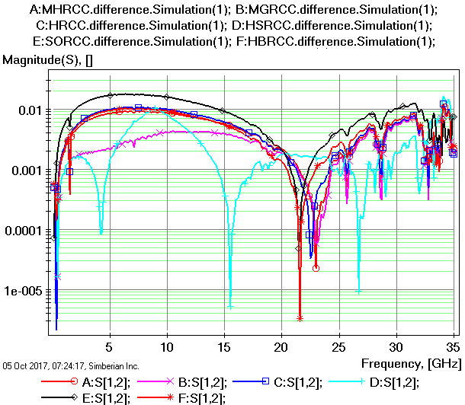
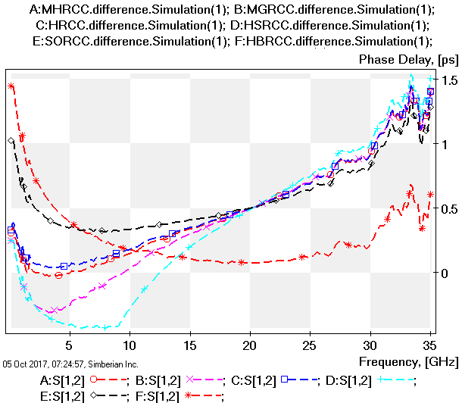
Difference in GMS magnitude and phase delay: measured vs. identified
Modified Hammerstad (MHRCC, red o): SR=0.313 um, RF=2.595;
Huray (HRCC, blue squares): SR=0.123 um, RF=7.846;
Modifed Groiss (MGRCC, purple x): SR=0.216 um, RF=2.759;
Hemispherical (HSRCC, cyan +): SR=0.563 um, RF=3.969;
Bushminskiy (BRCC, black rhombs): SR=0.362 um, RF=2.405;
Huray-Bracken (HBRCC, red *): SR=0.123 um, RF=7.846;
Dielectric model is Wideband Debye: Dk=3.811, LT=0.00111 @ 1 GHz
Dk=3.787, LT=0.00111 @ 1 GHz
MGRCC
HBRCC
Higher inductance and lower Dk increase impedance. No way to validate – CMP-28 was not cross-sectioned!

Slide 27
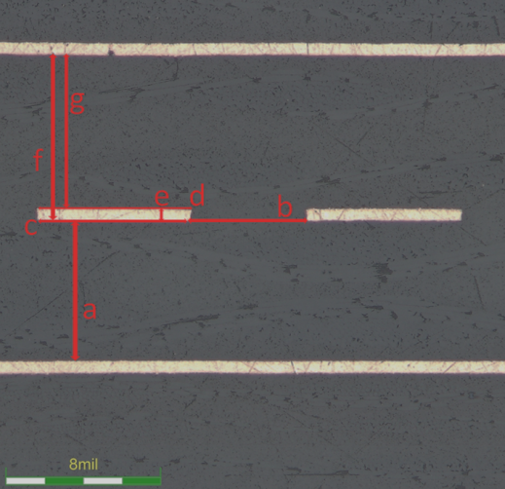
Practical example with cross-sectioning
Differential strip with FEXT, HVLP copper
FR4
mostly resin
FR4
Details in App Note #2017_03 at www.simberian.com
FR4: Dk=3.54, LT=0.0058 @ 1 GHz; Resin: Dk=3.76, LT=0.0058 @ 1 GHz; Roughness: Modified Groiss SR=0.19 um, RF=2.75
FR4: Dk=3.465, LT=0.002 @ 1 GHz; Resin Dk=3.63, LT=0.002 @ 1 GHz; Roughness: Huray-Bracken SR=0.2 um, RF=7.75

Slide 28
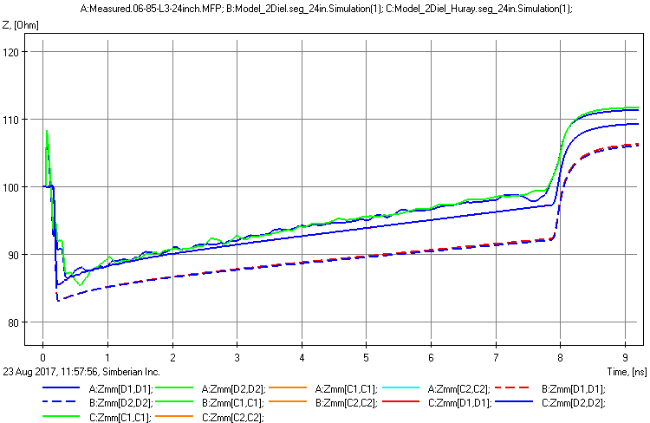
Validation with TDR
24-inch segment
Huray-Bracken roughness model with copper resistivity adjusted at to match IL at low frequency
measured
Modified Groiss roughness model (non-causal)

Slide 29
Conclusion
Unified 2-parameter form for most of the roughness correction coefficients with additive and multiplicative extensions is proposed
Some observations on the roughness
All mentioned roughness correction coefficients are “heuristic”
We definitely know that the roughness increases the losses – no doubts about it and all RCCs predict it
Drawing flat boundary changes both capacitance and inductance of the model – may be interpreted as capacitance or inductance of rough surface
Some surfaces may increase the inductance above predicted by the Wheeler’s rule and beyond the boundary positioning – accounted in Huray-Bracken RCC
Some surfaces may increase the capacitance beyond the boundary positioning – cannot be accounted by RCCs

