Slide 1
High-Speed Digital Field Visualization of Currents and Crosstalk
Yuriy Shlepnev – Simberian Inc.
Presented at Signal Integrity webinar on August 15, 2017

Slide 2
Dr. Yuriy Shlepnev Simberian Inc.
Yuriy Shlepnev is President and Founder of Simberian Inc., where he develops Simbeor electromagnetic signal integrity software. He received M.S. degree in radio engineering from Novosibirsk State Technical University in 1983, and the Ph.D. degree in computational electromagnetics from Siberian State University of Telecommunications and Informatics in 1990. He was principal developer of electromagnetic simulator for Eagleware Corporation and leading developer of electromagnetic software for simulation of signal and power distribution networks at Mentor Graphics. The results of his research are published in multiple papers and conference proceedings.

Slide 3
Outline
Introduction
Electromagnetic field visualization basics
Current crowding, skin-effect, power flow
Cross-talk microstrips and strips
Cross-talk in vias
Conclusion

Slide 4
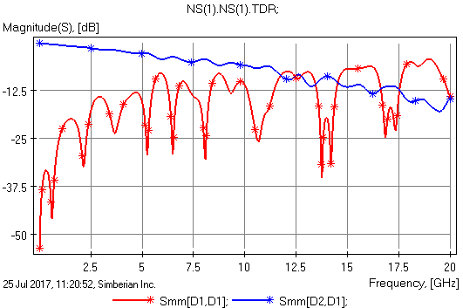
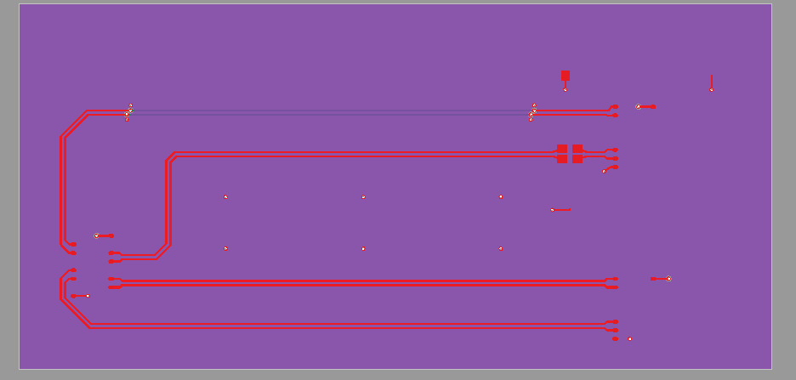
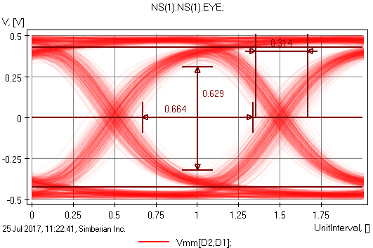
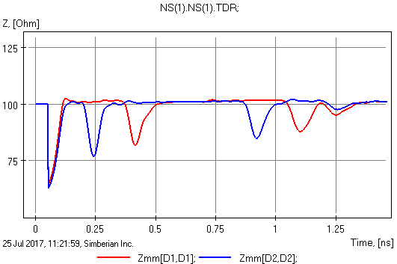
PCB/Packaging interconnects: multiport or black-box description
Compute and measure Multiport Parameters
Port2
Port1
S-parameters
Eye Diagram
TDR/TDT
Let’s take closer look at how we usually model it…

Slide 5
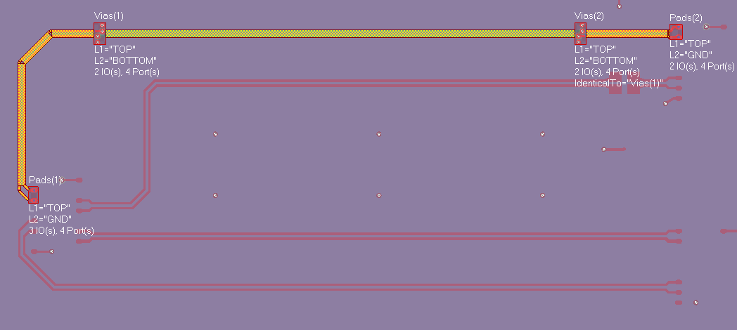
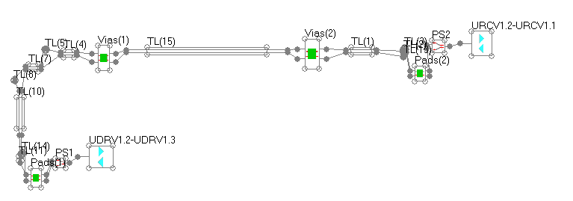
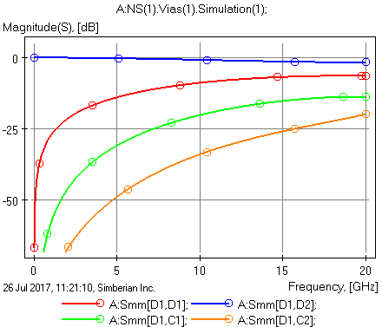
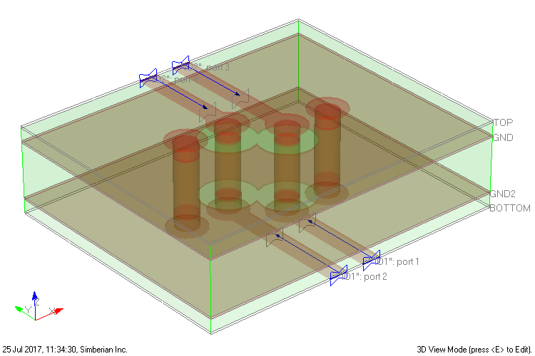
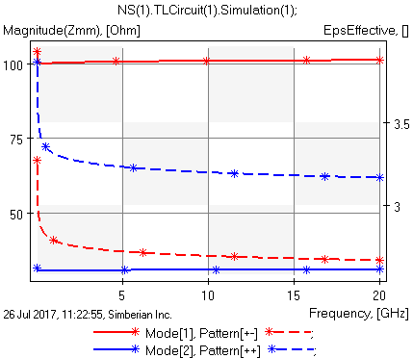
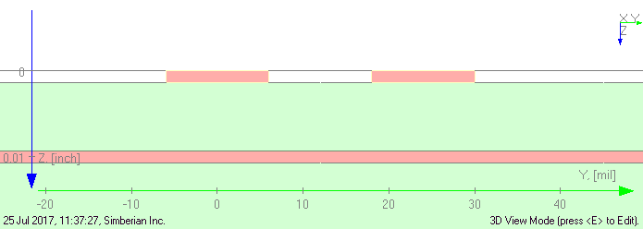
Analysis – more “black boxes”
Multiport Circuit (connection of multiports)
Discontinuities (multiports)
S-parameters
Transmission line segments (multiports)
Modal & RLGC
What is inside of those “black boxes”?
See more at Y. Shlepnev, “Decompositional Electromagnetic Analysis of Digital Interconnects”, IEEE Int. Symp. on Electromagnetic Compatibility (EMC2013), Denver, CO, 2013, p.563-568.

Slide 6
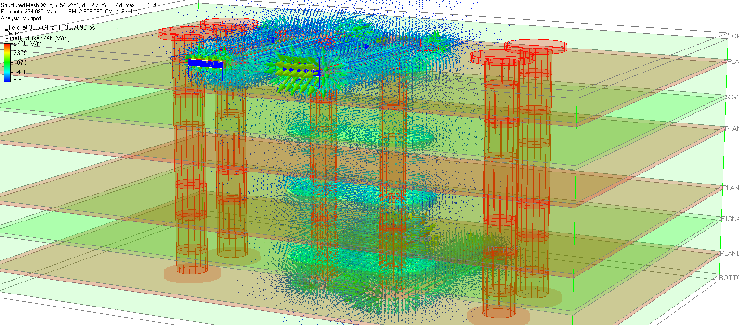
“Black box” contains fields
[S]
Looking at the S-parameters/TDR/TDT/eye we see just the tip of an ICEBERG!
What we do not usually see contains a lot of information that is almost never “measured”, but is critical to revealing “How interconnects work”
Electric and magnetic fields, current densities, power flow density…

Slide 7
Fields are described by Maxwell’s equations
Gauss’s laws
- Electric Intensity (V/m)
- Magnetic Intensity (A/m)
Continuity (Kirchhoff’s current law)
- Electric Flux (Coulomb/m^2)
- Magnetic Flux (Tesla or Weber/m^2)
- Free Charge Density (Coulomb/m^3)
Ampere’s law
- Free Current Density (A/m^2)
Faraday’s law (Kirchhoff’s voltage law)
- Polarization (Coulomb/m^2)
- Magnetization (A/m)
Fields in materials
Plus material equations and boundary conditions….
Very complicated to say the least ☺
Visual Computational Electromagnetics may be helpful tool to understand…

Slide 8
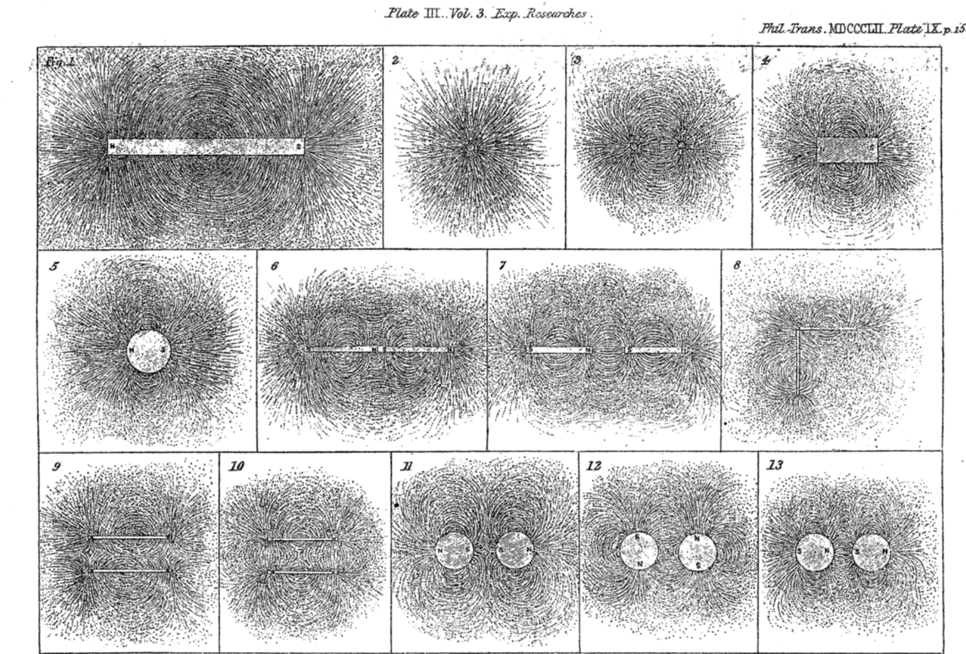
Field visualization in 19th century
Faraday visualized fields with the iron fillings and almost never used equations;
He discovered and described electromagnetic induction (Faraday’s law) using words only;
That leaded to the discovery of the Maxwell’s equations…
Michael Faraday, Experimental Researches in Electricity, 1855

Slide 9
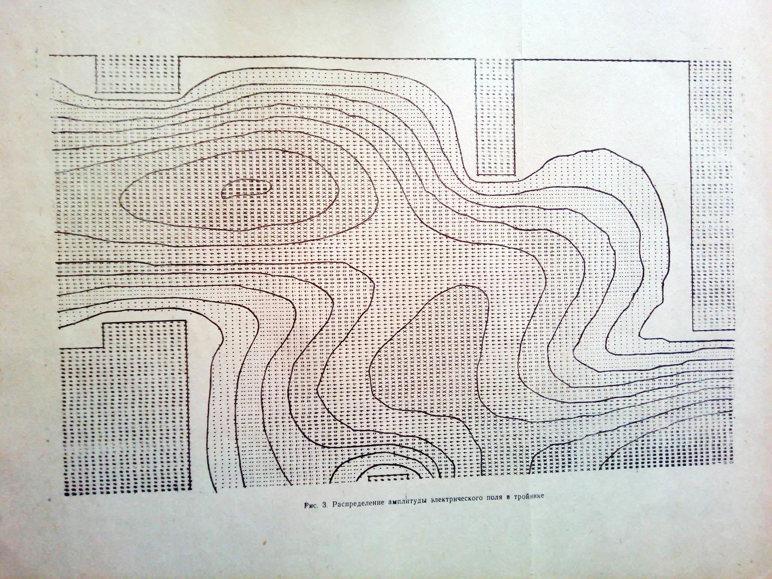
EM fields visualization – 70s & 80s
Use of printers:
Electric Field in rectangular waveguide T-junction
Print out from VOLNA software of B.V. Sestroretzkiy, V.M. Seredov, N.A. Sadovnikov, МНИИП (now Corporation Vega)
TE10 wave

Slide 10
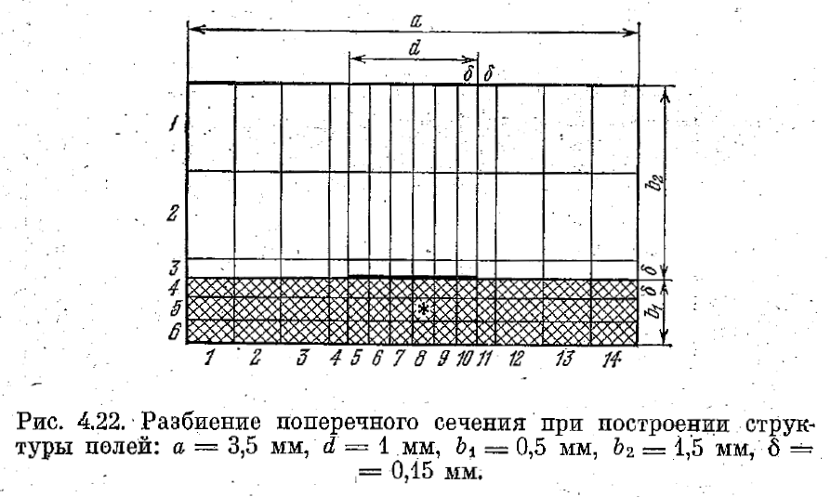
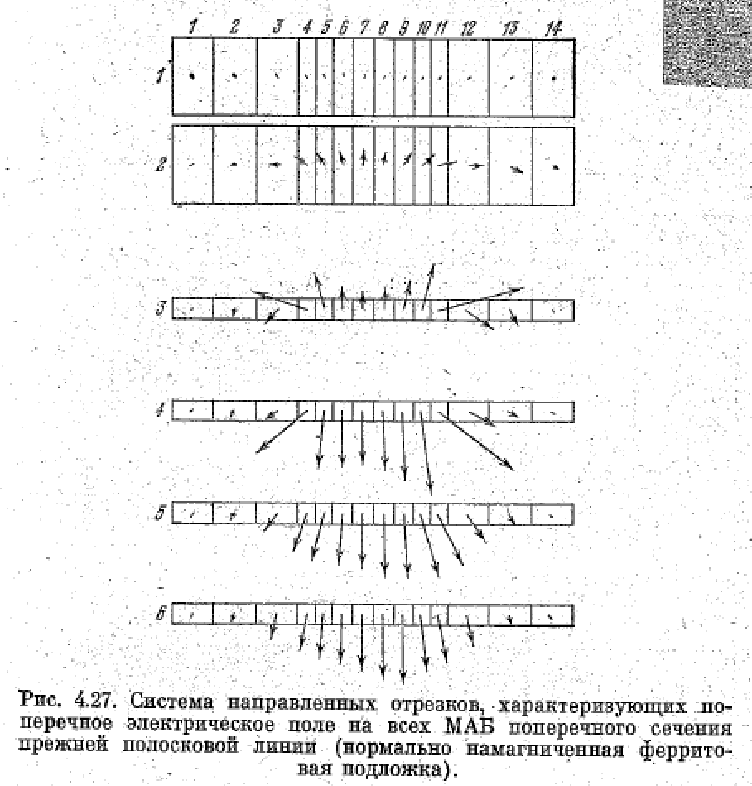
EM fields visualization – 70s & 80s
Electric fields in microstrip line on magnetized ferrite substrate computed with Minimal Autonomous Blocks (Treftz’s finite elements)
From В.В. Никольский, Т.И. Никольская, Декомпозиционный подход к задачам электродинамики, Наука, 1983, с. 176-181.

Slide 11
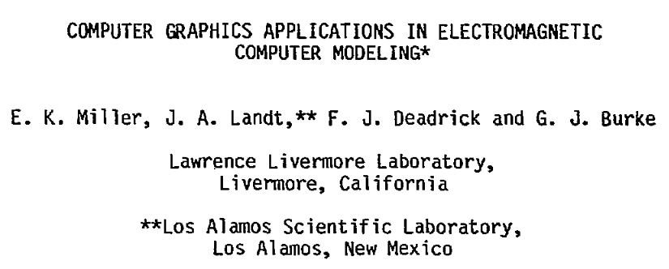
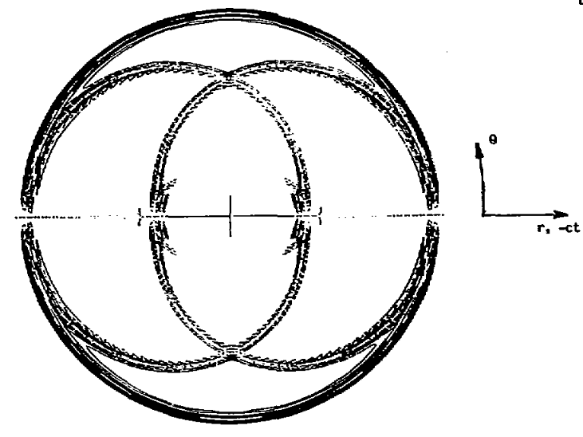
EM fields visualization – 70s & 80s
IEEE Antennas and Propagation Society International Symposium, 1981, p. 634-637.
Far-field space-time contour plot for a Gaussian-pulse excitation of a center-fed dipole, 1981
Mostly use of plotters and printers until 90s …

Slide 12
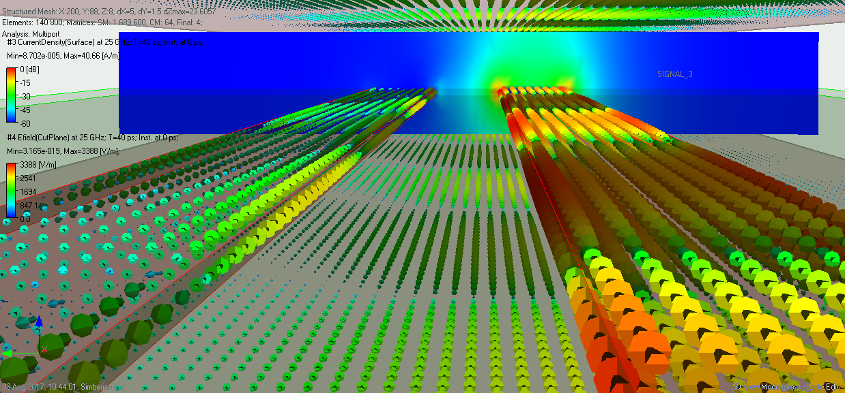
90s and 2000s - gaming changed everything…
Personal computers and console video games took a great graphical leap forward in the 2000s, becoming able to display graphics in real time computing that had previously only been possible pre-rendered and/or on business-level hardware (https://en.wikipedia.org/wiki/Computer_graphics).
Surface current density and electric field in strip lines computed and visualized in Simbeor software

Slide 13
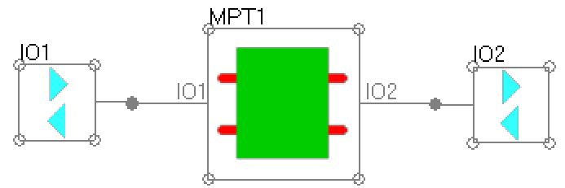
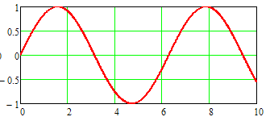
Time and Frequency Domains
Signal -> Harmonics
Response -> superposition of distorted signal harmonics
[S]
t
t
Signal degradation in interconnects are caused by dielectric and conductor loss and dispersion, high-frequency non-TEM wave dispersion, effect of discontinuities (ISI or multiple reflection) and radiation;
The best way to model those effect is in the FREQUENCY DOMAIN (our focus);
All fields, currents and power are real parts of time-harmonic complex vectors
Excitation – single frequency sinusoidal voltage sources
frequency
period

Slide 14
Time-harmonic vector fields
Instantaneous field value: amplitude and direction are periodic functions of time
are complex numbers
Peak value:
Average value (for power flow):

Slide 15
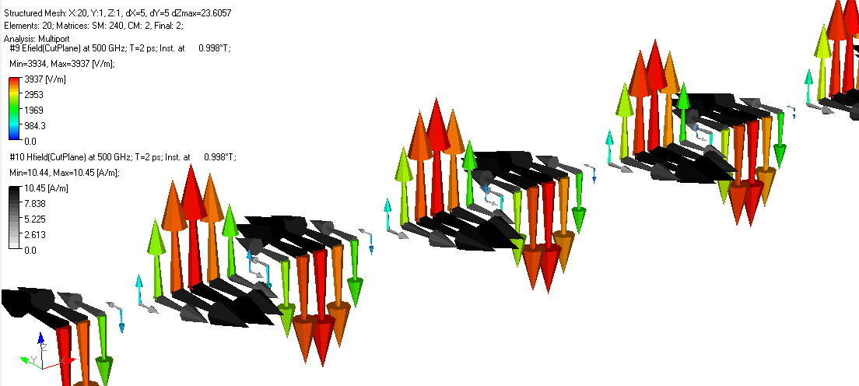
Equations or Pictures
Plane wave solution
wavelength
(animated)
Which one do you understand?
Which one will you remember?
Richard Feynman: Dirac said that to understand a physical problem means to be able to see the answer without solving equations. Maybe he exaggerated; maybe solving equations is experience you need to gain understanding. But until you do understand, you're just solving equations. - 1979

Slide 16
Field modeling technique: Trefftz Finite Elements
Element interior fields (exact solution of Maxwell’s equations):
Projection on boundaries
S-parameters of Trefftz element
[S]
S-parameters of structure
V.V. Nikol’skii, T.I. Lavrova, “The method of minimum autonomous blocks and its application to waveguide diffraction problems,” Radio Engineering & Electronic Physics, vol. 23, no. 2, p.1-10, 1978.
V.V. Nikol’skii, T.I. Nikol’skaia, Decompositional approach to electromagnetic problems. Moscow: Nauka, 1983 (in Russian).
Y.O. Shlepnev, Trefftz finite elements for electromagnetics. - IEEE Trans. on Microwave Theory and Techniques, vol. MTT-50, pp. 1328-1339, May, 2002.

Slide 17
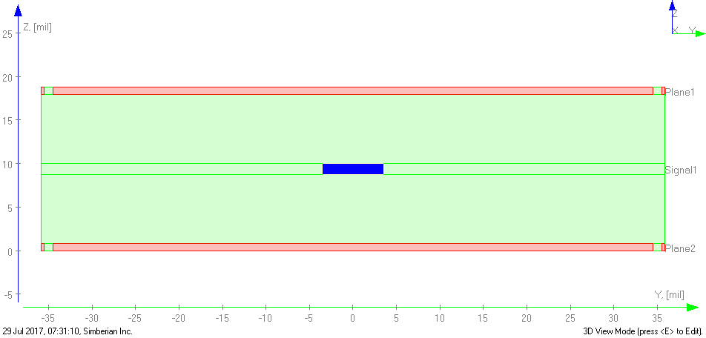
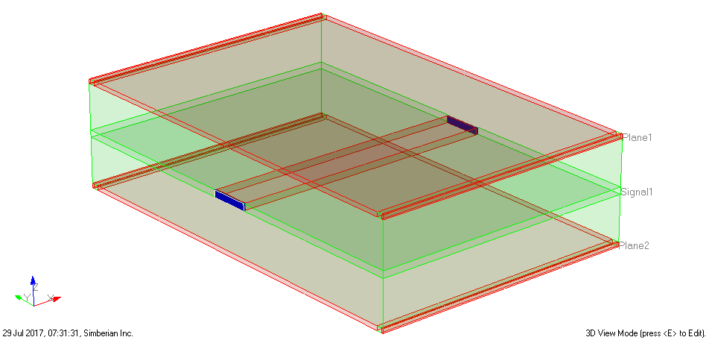
Fields and currents in strip line
Strip 1.2 mil thick, 7 mil wide
Dk=3.76, LT = 0.006 @ 1 GHz
1 V, 50 Ohm
50 Ohm
~50 Ohm
Planes 0.77 mil thick, 17.2 mil apart
-
+
Vpeak ~ 0.5 V
Ipeak ~ 0.01 A
50 Ohm
Modal and RLGC(f) parameters are extracted from the analysis of small segment in Simbeor for analysis of traces with arbitrary length
1 V, 50 Ohm
Example from demo-video #2016_03: How Interconnects Work™: EM field, current and power flow in strip line

Slide 18
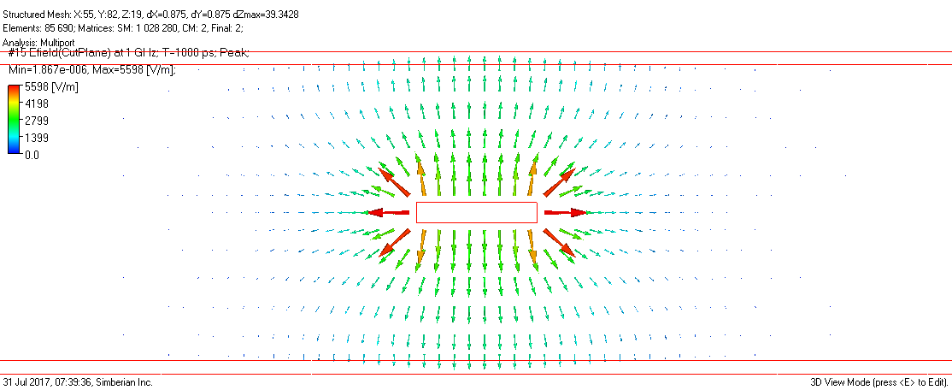
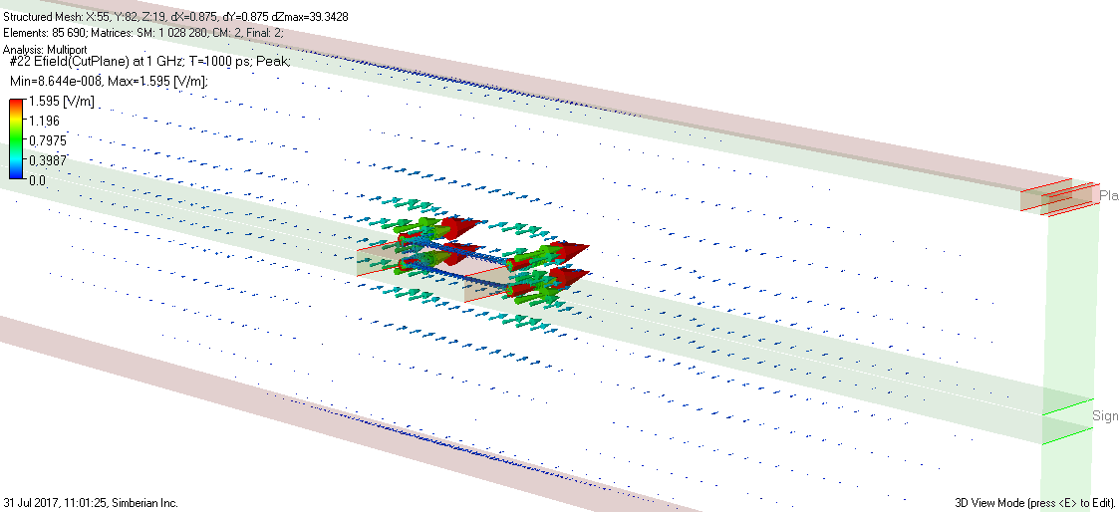
Electric Field at 1 GHz
Electric Field (V/m, peak values)
-
-
-
Voltage
+
+
+
Transverse components
Will integration path matter?
Is it transverse (TEM) wave?
-
-
-
Longitudinal component (small)
Hint: No longitudinal components only without losses in conductor and dielectric

Slide 19
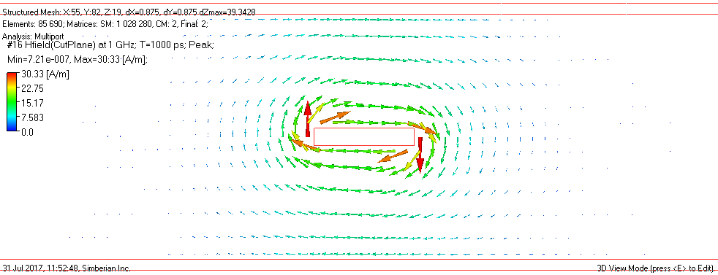
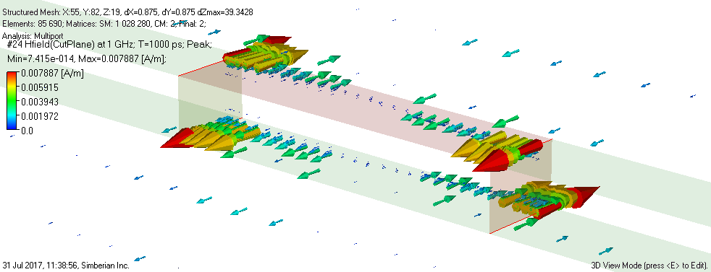
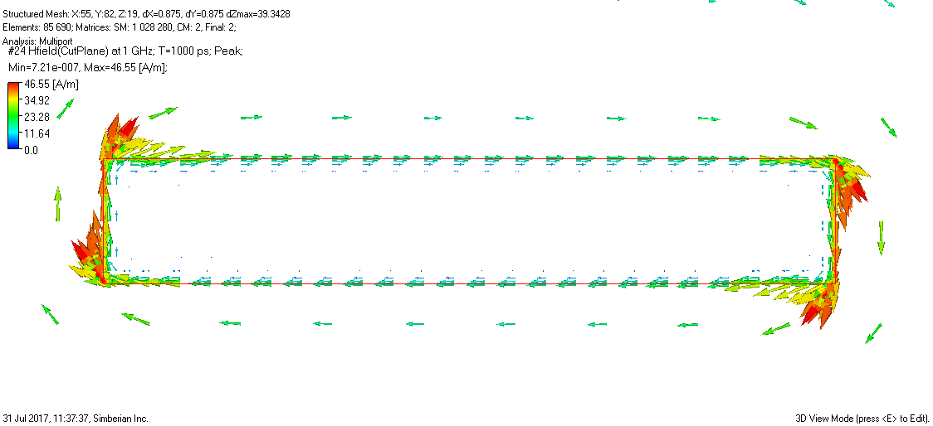
Magnetic Field at 1 GHz
Magnetic Field (A/m, peak values)
Currents
Transverse components
Displacement current (bound charges)
Conduction current (free charges)
Longitudinal component (small)
Field inside conductor

Slide 20
Currents in Ampere’s law
Displacement in vacuum and polarization currents
Conduction current (A/m^2)
electric field
+ + + + + + + + + +
electric field in vacuum
+
V
- - - - -
+
V
polarization
-
+ + + + +
smaller electric field in dielectric
-
- - - - - - - - - -
current
Polarization [Coulomb/m^2] is displacement of charges bound to atoms, molecules, lattices, boundaries,… described by material (constitutive) equations (LTI):
Translational motion of free charges in electric field described by the Ohm’s law (LTI):
- bulk conductivity, Siemens/m
See more in the “Material World…” tutorial, DesignCon 2016 at www.simberian.com

Slide 21
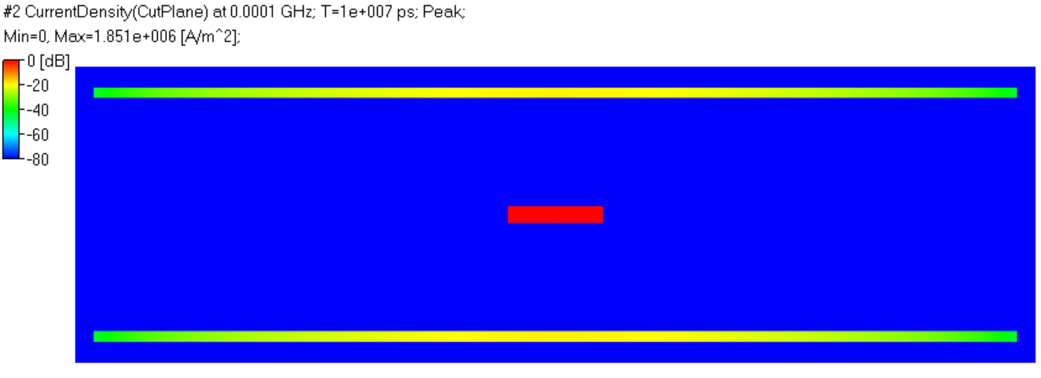
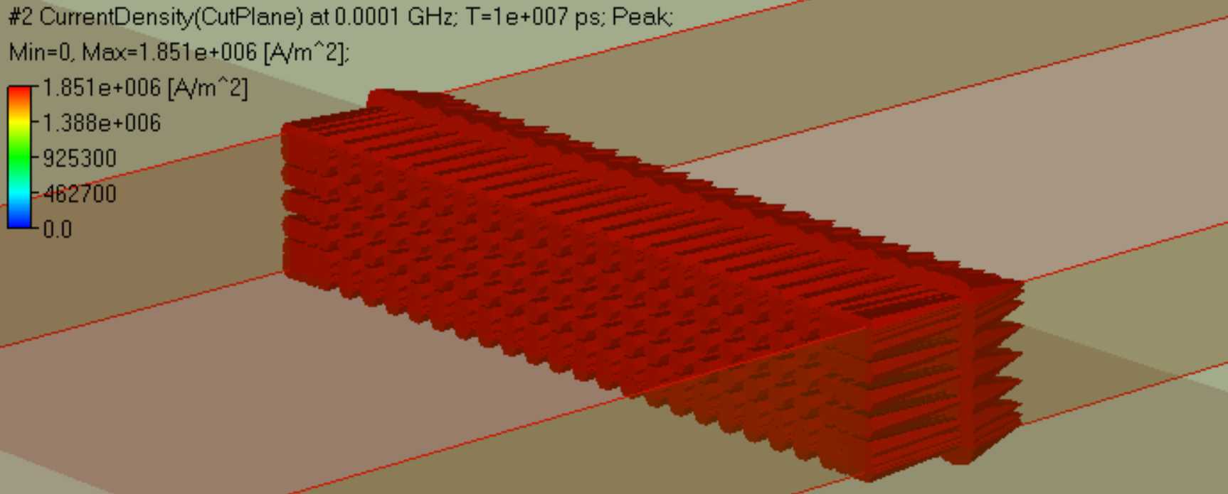
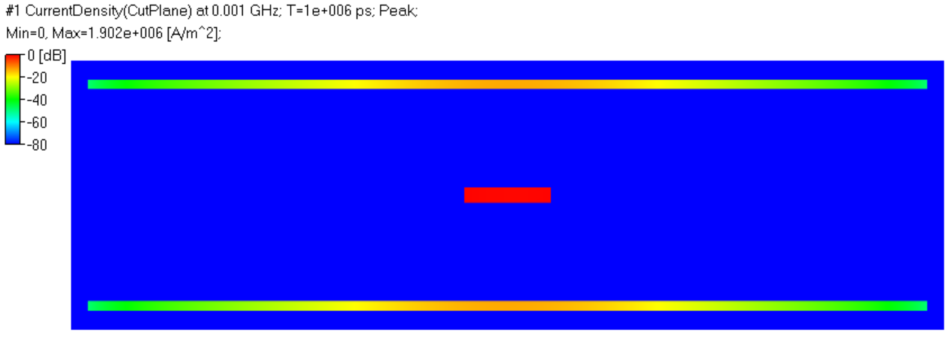
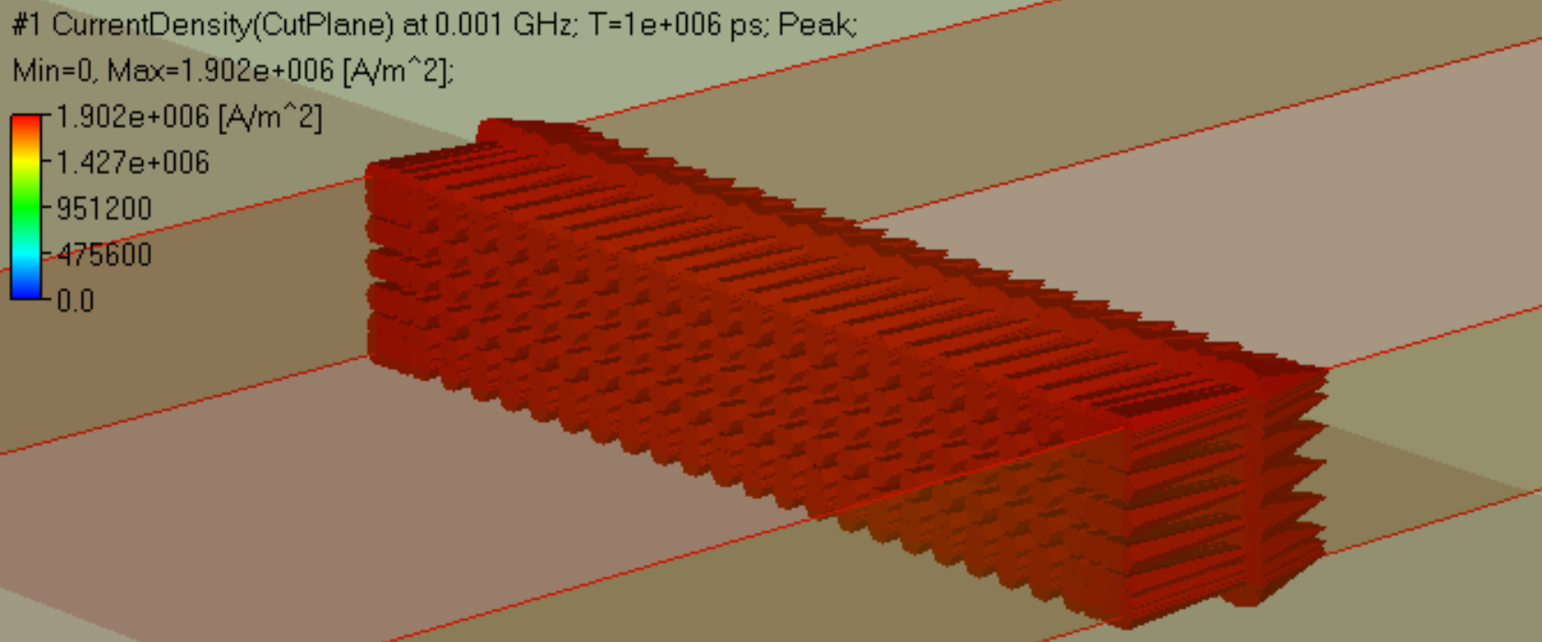
Current density in strip line: current crowding
Almost uniform distribution through thickness, both in planes and strip
f=0.1 MHz
sd=8.2 mil
t/sd=0.146
Is=0.01 A
Ir=-0.005 A
f=1 MHz
sd=2.59 mil
t/sd=0.46
Concentration of current below the strip at higher frequency
Strip width 7 mil, t=1.2 mil, planes 0.77 mil;
Peak values are shown; sd is skin depth;

Slide 22
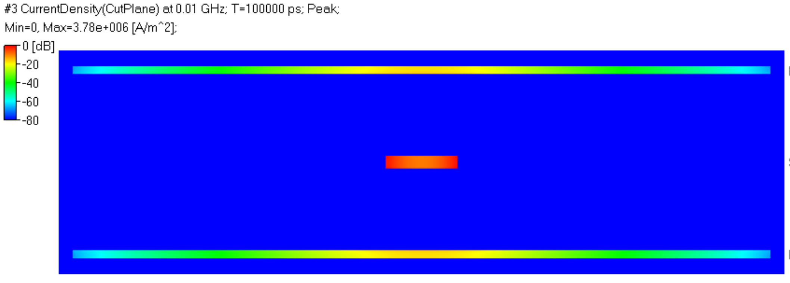
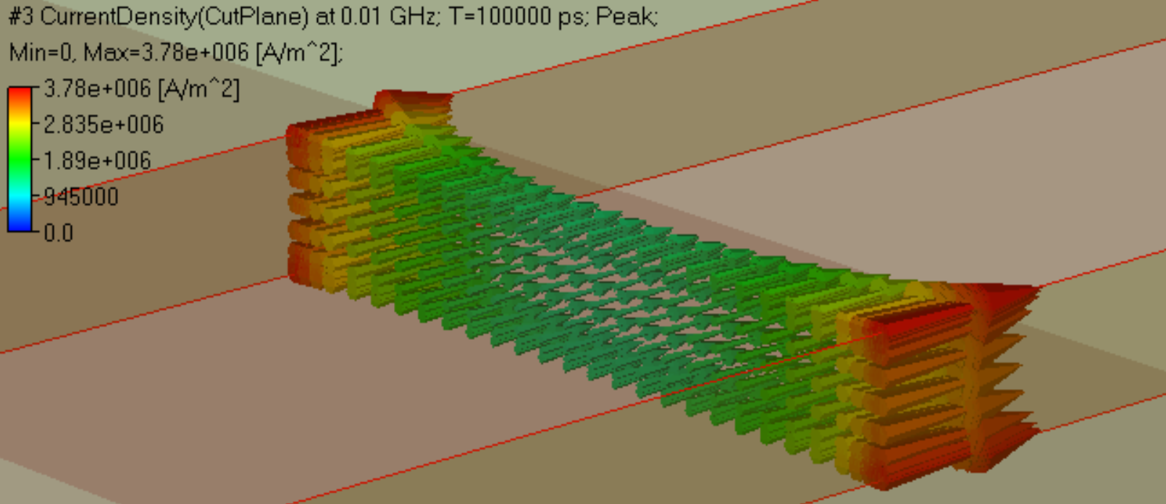
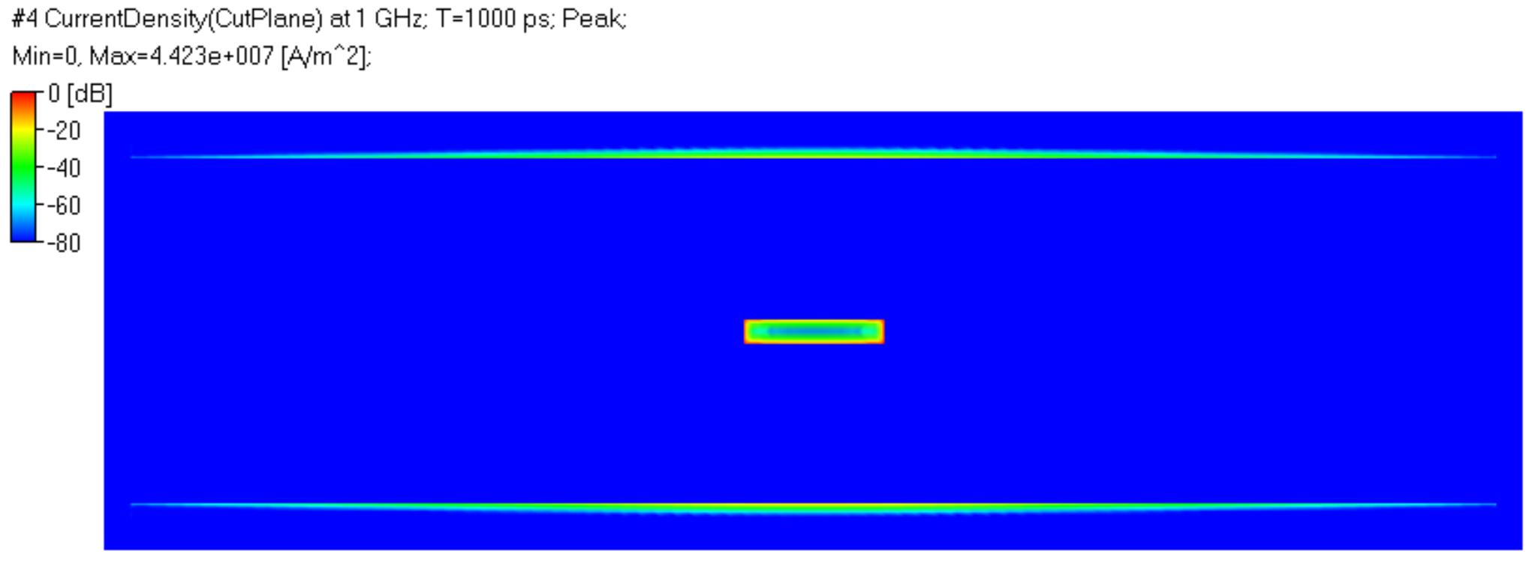
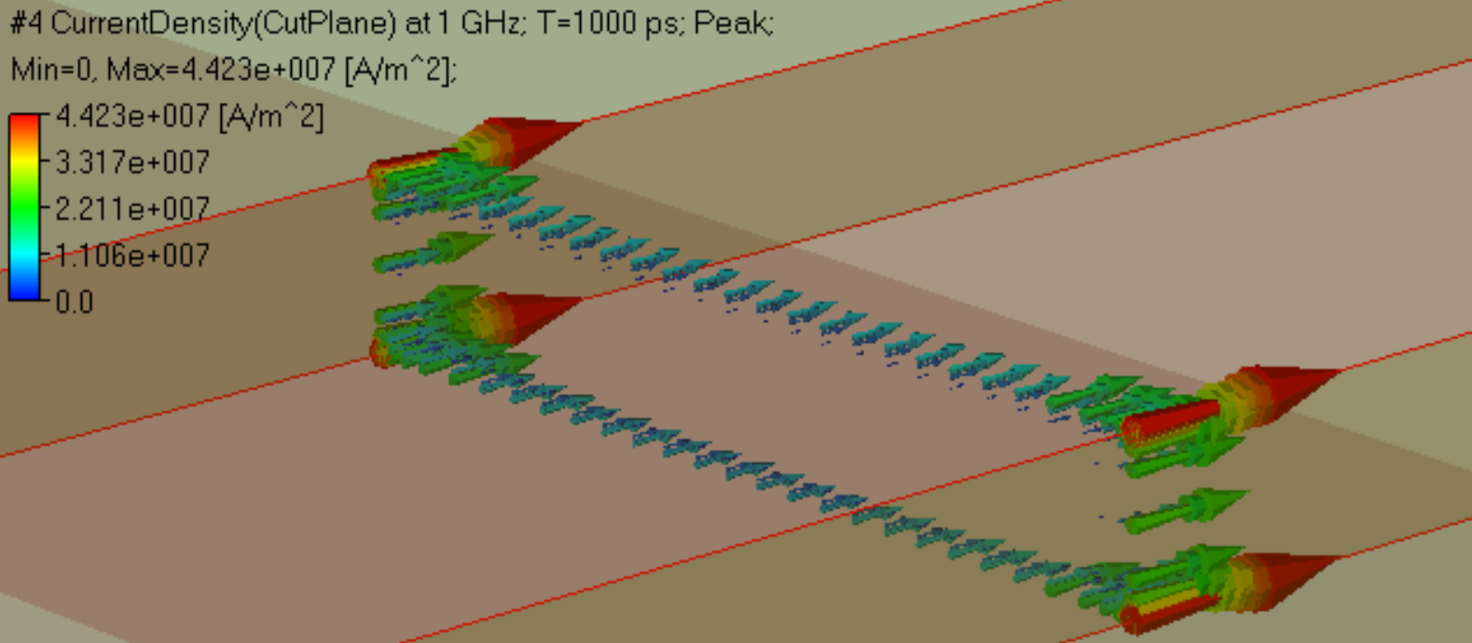
Current density in strip line: transition to skin-effect
Non-uniform current distribution - onset of the skin-effect in strip
f=10 MHz
sd=0.82 mil
t/sd=1.46
f=1 GHz
sd=0.082 mil
t/sd=14.6
Strip width 7 mil, t=1.2 mil, planes 0.77 mil;
Peak values are shown; sd is skin depth;
Current flow in thin layer at 1 GHz (typical PCB)

Slide 23
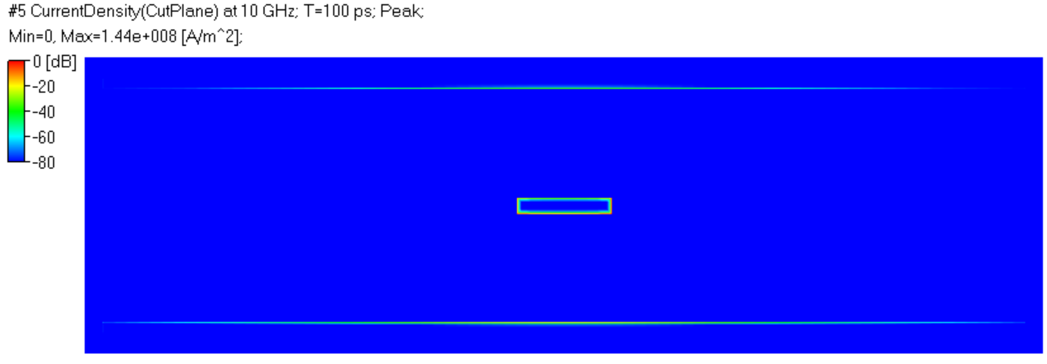
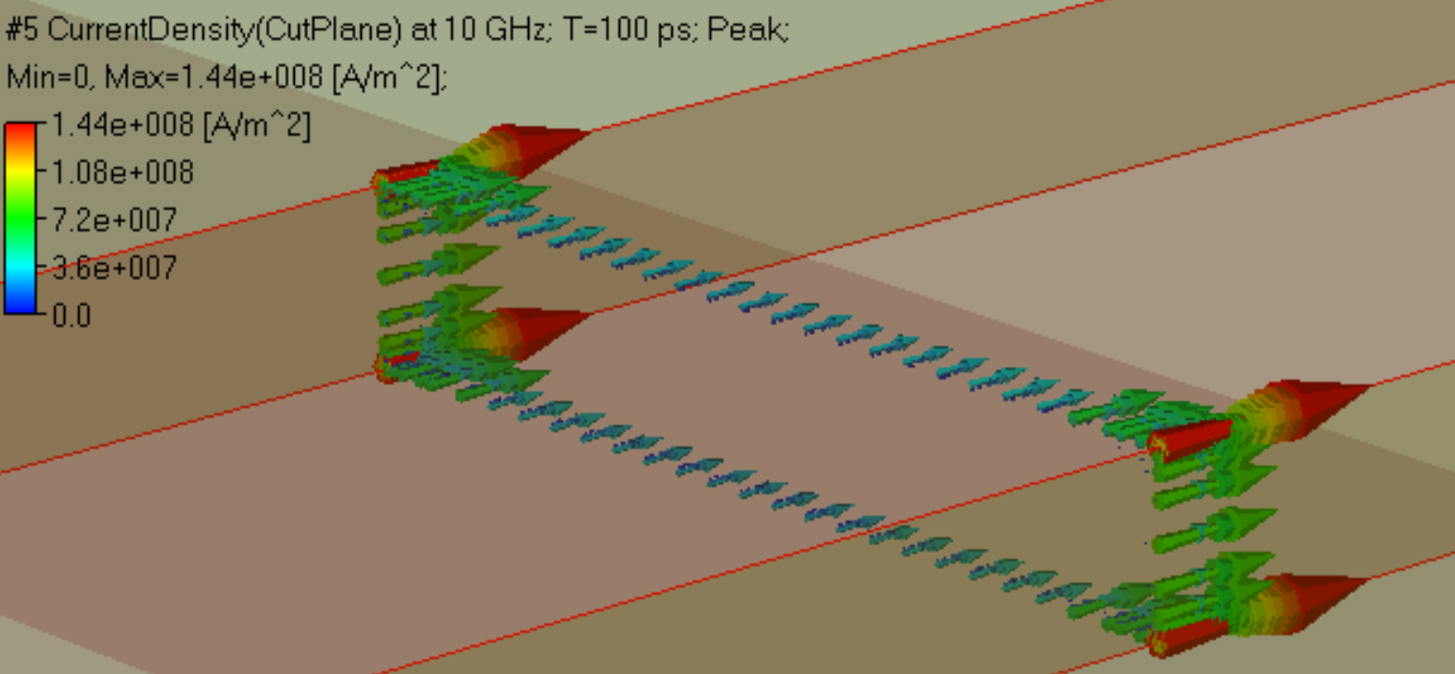
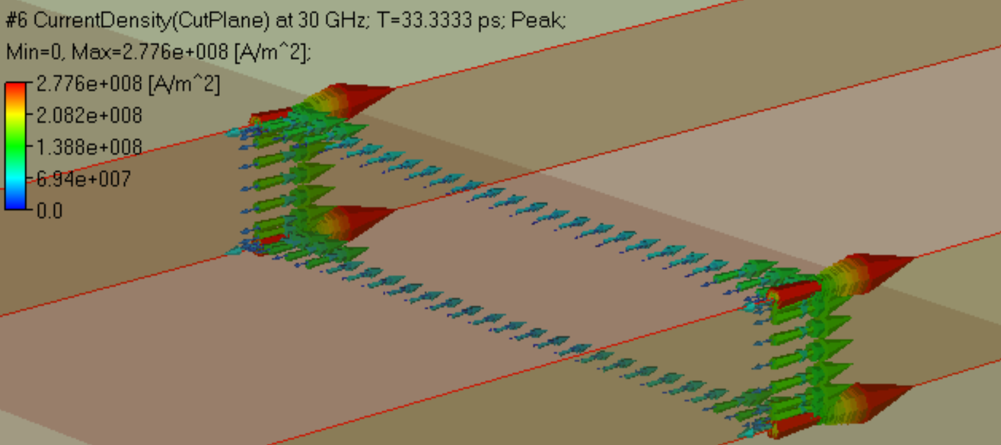
Current density in strip line: well-developed skin-effect
Current flow in very thin layer of conductor, higher currents at the edges
f=10 GHz
sd=0.026 mil
t/sd=46.15
f=30 GHz
sd=0.015 mil
t/sd=80
Is=0.01 A
Ir=-0.005 A
Maximal currents are at the edges – the edge singularity at high frequencies
Strip width 7 mil, t=1.2 mil, planes 0.77 mil;
Peak values are shown; sd is skin depth;

Slide 24
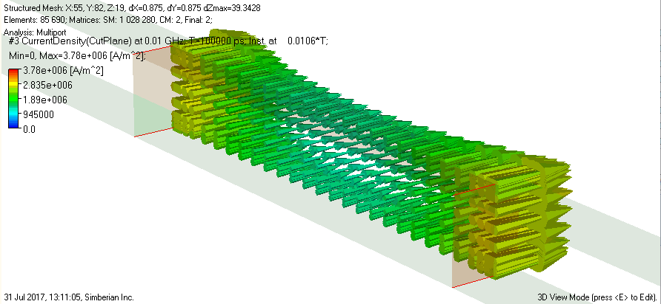
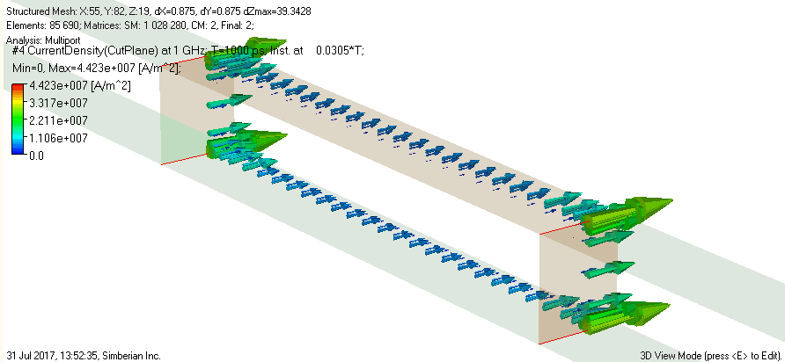
Skin depth and reversal of current
Current density in strip at 10 MHz (sd = 0.82 mil)
Plane-wave solution inside conductor
Poynting’s vector
Current density in strip at 1 GHz (sd = 0.082 mil)
y
Skin depth
(animated)

Slide 25
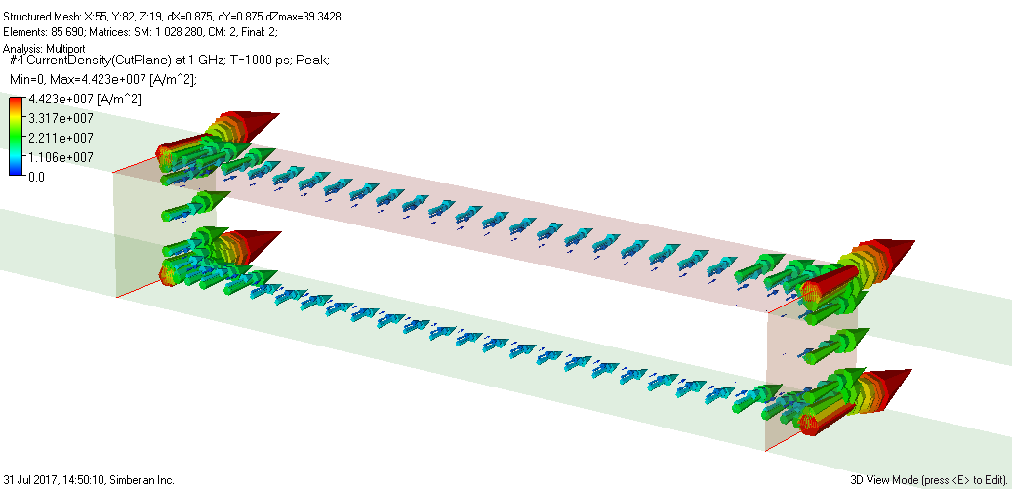
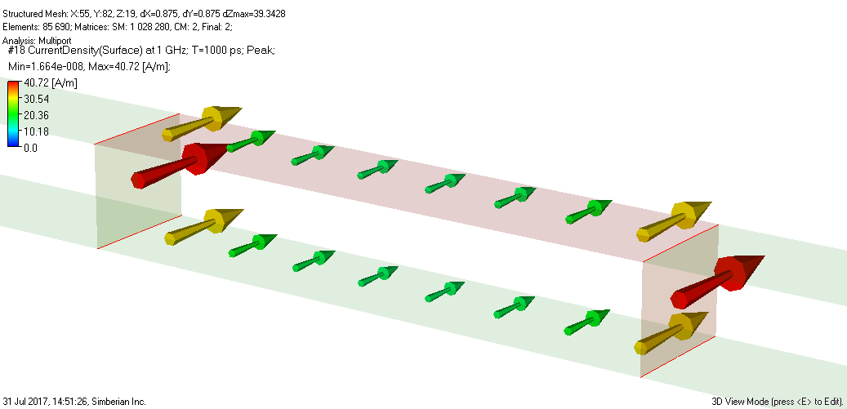
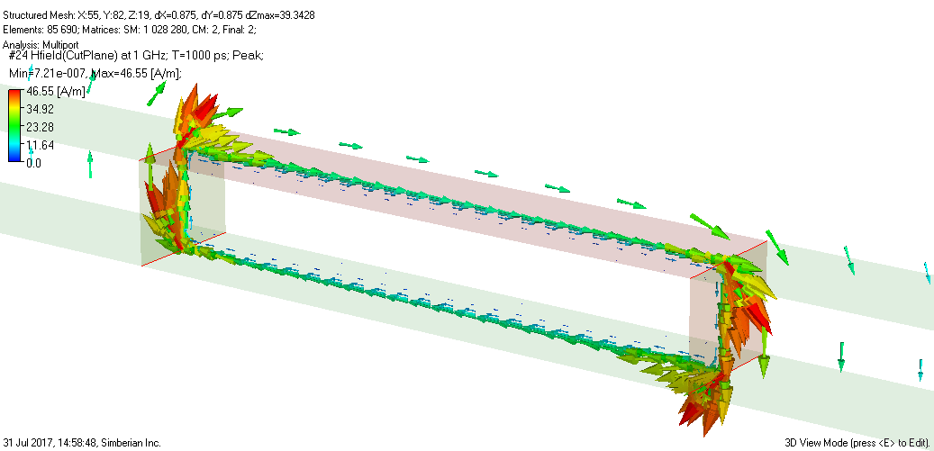
Surface current density
Current density (A/m^2)
Surface current density (A/m)
Magnetic field intensity -> current in circuit theory

Slide 26
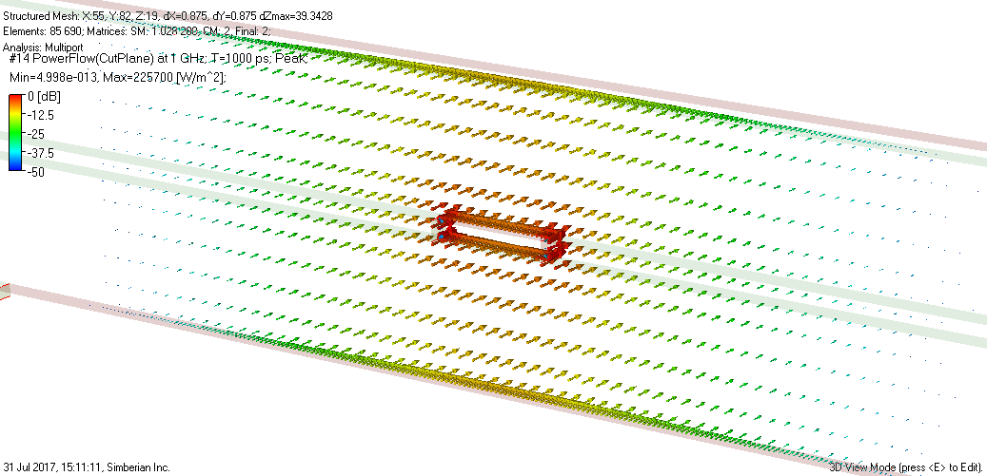
Power flow density at 1 GHz
Poynting vector is energy passing through unit area in 1 sec
Longitudinal component outside of conductors dominates
W/m^2
- circuit theory

Slide 27
Power flow in strip line
Peak value of power flow density [W/m^2]
Conductor interior
f=0.1 MHz
More power flows along the line closer to strip edges at higher frequency
Conductor absorbs power
f=10 MHz

Slide 28
Power flow in strip line
Peak value of power flow density [W/m^2]
Conductor interior absorbs more power (30 GHz), scaled arrows in dB
f=1 GHz
Power flow concentration near the strip edges continues as frequency rises
f=10 MHz
sd=0.82 mil
t/sd=1.46
f=30 GHz
Energy passing through conductor boundary is absorbed by the conductor

Slide 29
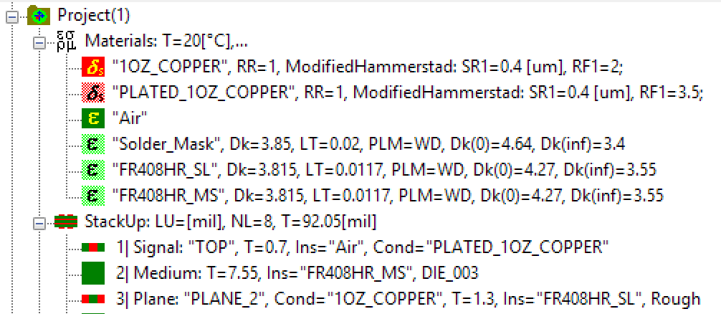
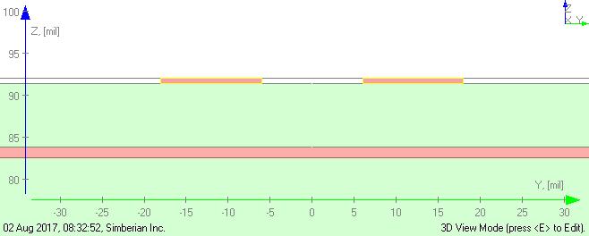
Cross-talk in microstrips
12-mil strips, 12 mil apart
50 Ohm, NEXT
50 Ohm, FEXT
1 V, 50 Ohm
50 Ohm, Through
NEXT: Near-End Crosstalk
FEXT: Far-End Crosstalk

Slide 30
Power flow density in microstrips
5 GHz, wavelength ~1.5 in
Small FEXT
25 GHz, wavelength ~0.3 in
Half of power goes into FEXT
50 GHz, wavelength ~0.15 in
Almost all power goes into FEXT
What if segment length is 5 inch?
(animated)

Slide 31
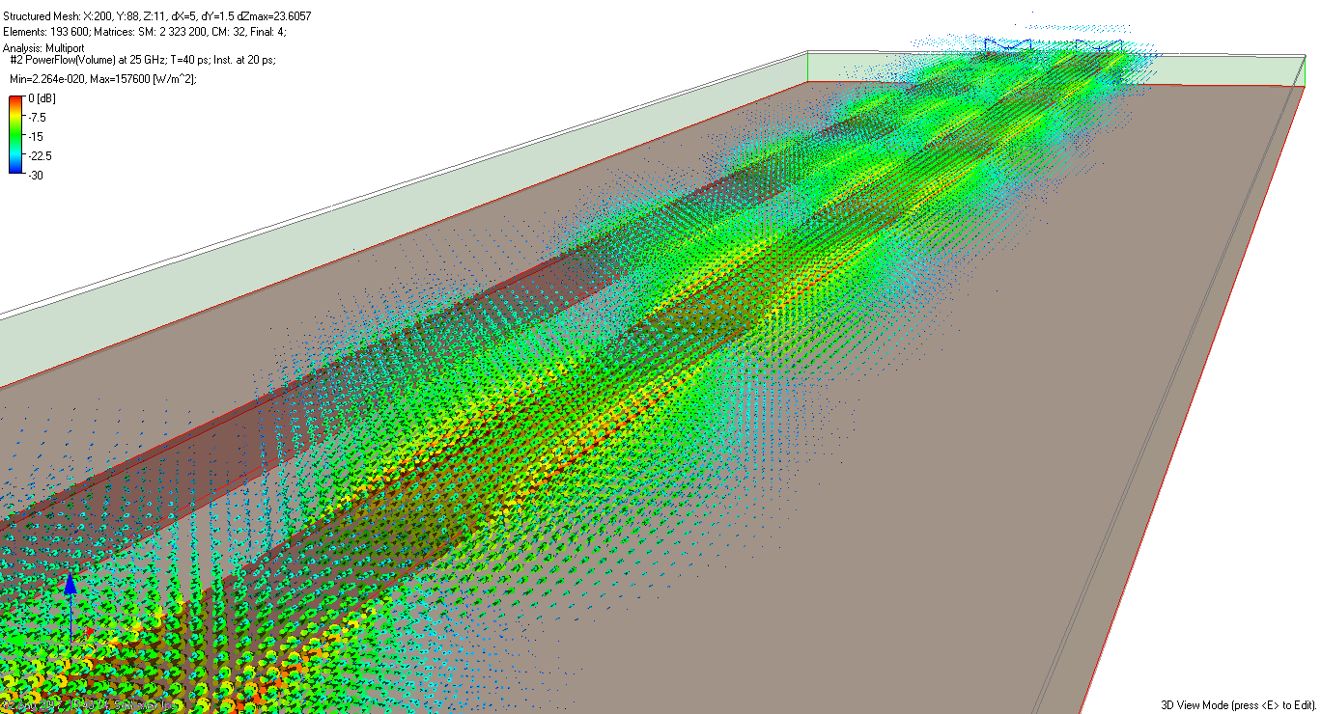
Power flow density in microstrip
25 GHz, wavelength ~0.3 in
Instantaneous at 20 ps

Slide 32
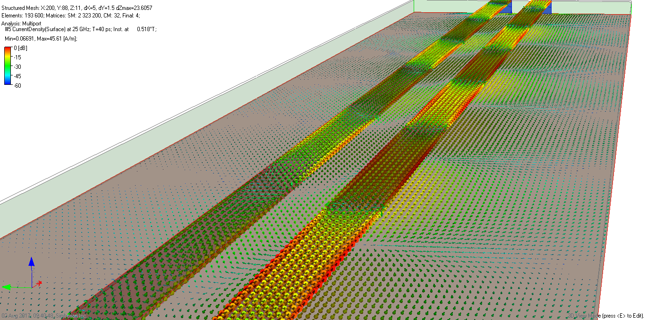
Surface current density in microstrip
25 GHz, wavelength ~0.3 in
Instantaneous at 20 ps
Almost identical currents in opposite directions
Current is mostly on the aggressor line
See more at demo-video #2016_11: How Interconnects Work™: Crosstalk power flow in microstrip lines

Slide 33
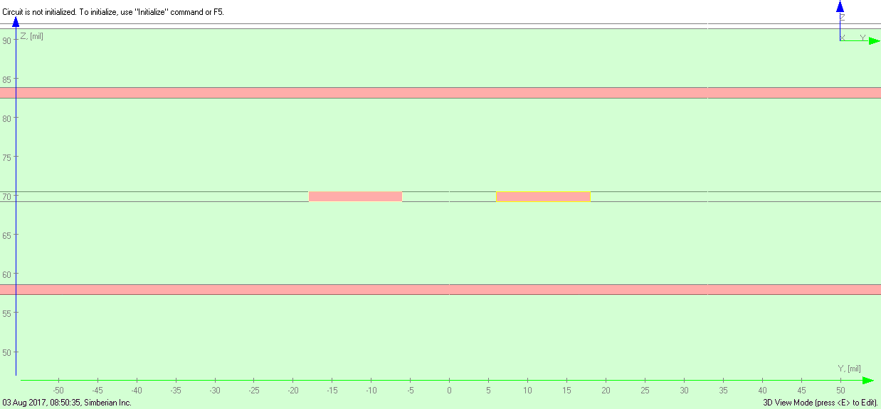
Power flow density at strip lines
25 GHz, wavelength ~0.3 in, Instantaneous at 0 ps
12-mil strips, 12 mil apart
Very small FEXT
Looks like nothing going on the victim trace?
Very small NEXT
1 V, 50 Ohm
See more at demo-video #2016_11: How Interconnects Work™: Crosstalk power flow in microstrip lines

Slide 34
Surface current density in strip lines
25 GHz, wavelength ~0.3 in, Instantaneous at 0 ps
1 V, 50 Ohm
Hint: superposition of even and odd modes
See more at demo-video #2016_11: How Interconnects Work™: Crosstalk power flow in microstrip lines

Slide 35
Cross-talk in differential vias
NEXT – S[D1,D3]
Two coupled differential vias in a 120 x 120 mil area caged with PEC wall
Vias are 30 mil apart, antipad 25x55 mil, traces 8 mil MSL, 8 mil separation;
The first cage resonance is at about 12 GHz (half wavelength in dielectric)
Stackup from CMP-28 board, Wild River Technology http://wildrivertech.com
See more at App Note #2013_06 at http://www.simberian.com/AppNotes.php
p1
p3
p2
p4
Three cases:
FEXT – S[D1,D4]
20 mil
40 mil
40 mil + 5 vias

Slide 36
Power flow density in closely spaced differential vias
(animated)
5 GHz
30 GHz
small NEXT
NEXT
Differential excitation, half of the structure is shown
FEXT

Slide 37
Power flow density in 40-mil separated differential vias
(animated)
5 GHz
30 GHz
smaller NEXT
Differential excitation, half of the structure is shown
smaller FEXT

Slide 38
Power flow density in differential vias with stitching vias
(animated)
5 GHz
30 GHz
no NEXT
Differential excitation, half of the structure is shown
Very small FEXT

Slide 39
Surface current density on planes and vias
TOP
Instantaneous current density at 30 GHz, t=2ps
BOTTOM

Slide 40
More visualization at www.simberian.com...
#2017_02: How Interconnects Work™: Microstrip over meshed reference plane in flex interconnects, 16 min
#2016_13: How Interconnects Work™: Crosstalk power flow in differential vias, 10 min
#2016_12: How Interconnects Work™: Crosstalk power flow in single-ended vias, 11min
#2016_11: How Interconnects Work™: Crosstalk power flow in microstrip lines, 12min
#2016_10: How Interconnects Work™: Coaxial connector launch localization, 10 min
#2016_09: How Interconnects Work™: Power flow in coaxial connector launch, 16 min
#2016_08: How Interconnects Work™: EM fields, surface current and power flow in single-ended vias - with and without stubs, 15 min
#2016_07: How Interconnects Work™: Conductor roughness part 2 - modelling with Roughness Correction Coefficients, 16 min
#2016_06: How Interconnects Work™: EM fields and power flow in differential vias, 16 min
#2016_05: How Interconnects Work™: Currents and power flow in differential vias, 10 min
#2016_04: How Interconnects Work™: Conductor roughness modeling with Effective Roughness Dielectric, 10 min
#2016_03: How Interconnects Work™: EM field, current and power flow in strip line, 10 min
#2016_02: How Interconnects Work™: Skin-effect in microstrip line - current density, 10 min
#2016_01: How Interconnects Work™: Skin-effect in microstrip line - EM fields and current density, 17 min

Slide 41
Conclusion
Usefulness of visualization
Better understand or electromagnetics
Better understanding of “How interconnects work”
Troubleshooting problem setup and software
Simbeor electromagnetic signal integrity software (Simbeor THz version 2017.02) is used for all computations and visualization plots
See more at app notes and demo-videos of “How Interconnects Work” at http://www.simberian.com

